Slide 1
World War II
What was happening when

Slide 2
War begins in Europe
In Europe, Poland became Hitler’s next target…
France and Britain now realized that the policy of appeasement (made with Hitler) had failed
“appeasement” = a policy of giving into aggression in order to avoid war
They promised to come to Poland’s aid if Germany invaded them

Slide 3
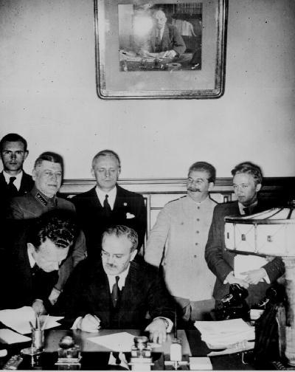
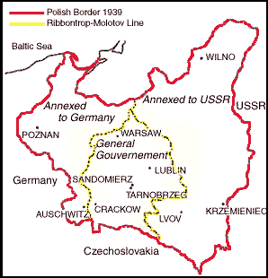
Invasion of Poland
Hitler and Stalin (two sworn enemies) had signed a non-aggression treaty…
What does this mean?
Hitler and Stalin agree when Hitler invaded Poland Russia would support Germany and after Poland was conquered the Poland would be divided between them.

Slide 4
Sides beginning to Form
Germany
Italy
Russia
Japan
AXIS POWERS
France
Great Britain
ALLIED POWERS
Russia changes sides after Hitler invades Russia’. “Operation Barbarossa

Slide 5
Hitler and Stalin

Slide 6
Poland attacked, September 1939
September 1, 1939 Germany attacks Poland.
16 days later Stalin’s forces seize eastern Poland. Stalin’s forces also annex Estonia,Lithuania, Latvia and invade Poland.
Blitzkrieg [“Lightening War”]

Slide 7
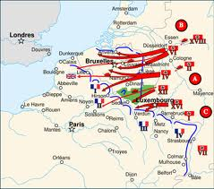
Fall of France
After Poland, Hitler’s armies seemed unstoppable – seized Denmark and Norway,the Netherlands, Luxembourg, and Belgium.
They then moved into France
Britain sent troops to help France resist the assault… and they were quickly overpowered !!!!!!!!
Barely 6 weeks later, France surrendered

Slide 8
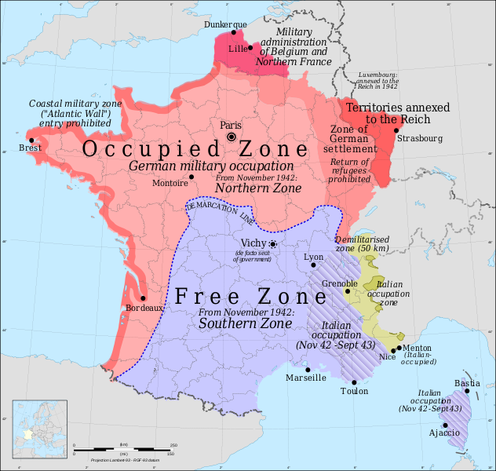

Slide 9
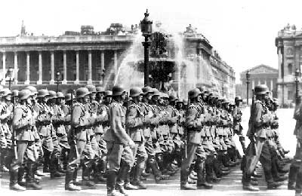
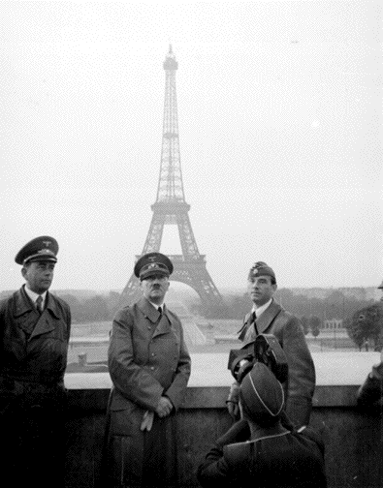
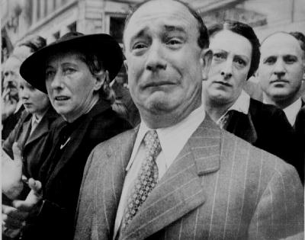
France Surrenders June, 1940

Slide 10
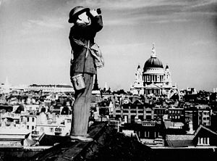
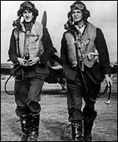
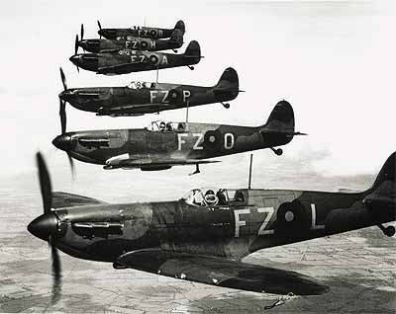
Britain stands alone…
Hitler ordered an assault on Britain
The raids took 1,000’s of lives, yet the British never gave in.
British air force fought the invading plans…
The fights continued through the summer
Hitler abandoned the invasion on Britain
BRITAIN STOOD ALONE

Slide 11
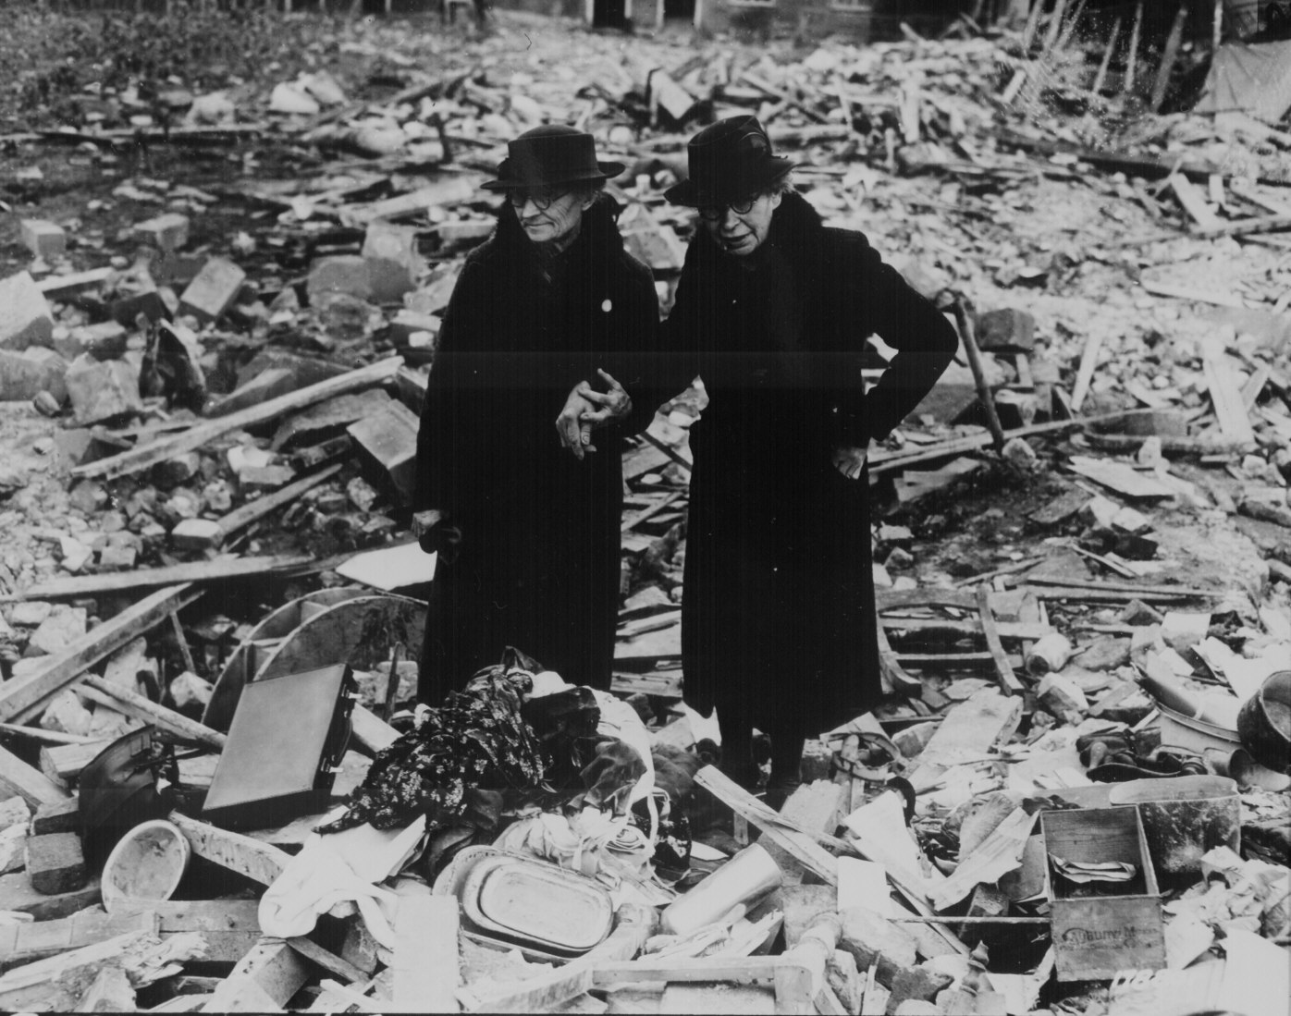
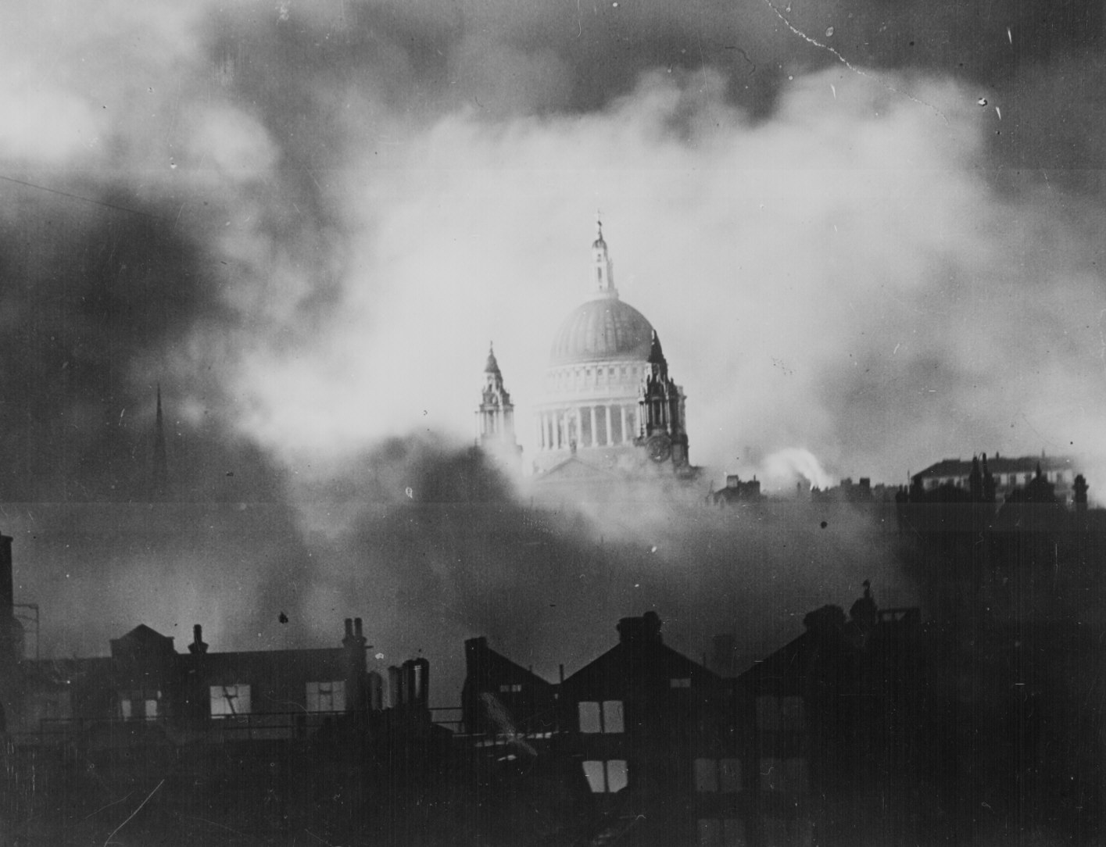
Battle of Britain: After a night of bombing

Slide 12
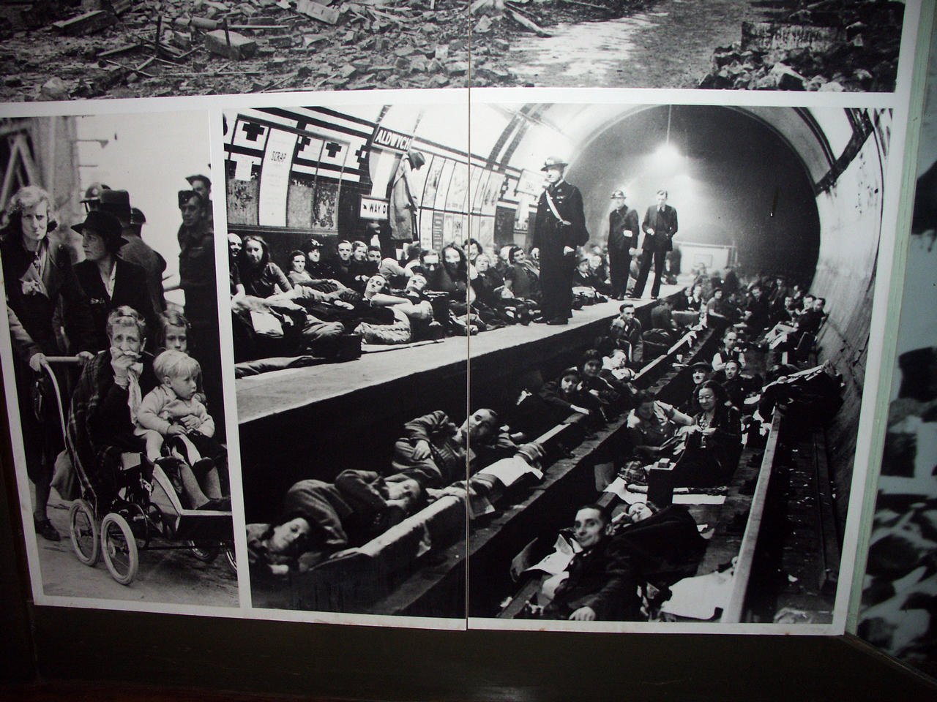
The London “Tube”: Air Raid Shelters during the Blitz

Slide 13
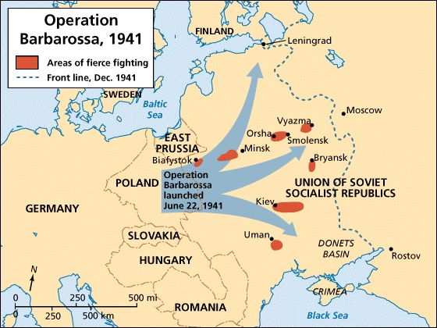
Operation Barbarossa: Hitler’s Biggest Mistake Invasion of the Soviet Union
On June 22, 1941, Hitler broke his pact with Stalin… Germany attacks the Soviet Union So who does the Soviet Union join forces with?

Slide 14
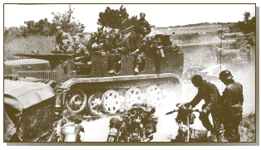
Operation Barbarossa: June 22, 1941 Hitler invades Russia
3,000,000 German soldiers and 3,400 tanks invade Russia.

Slide 15
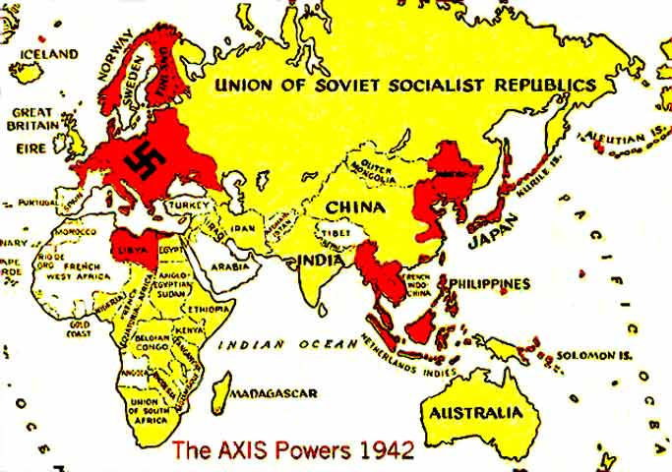
Russia joins the Allies
The Soviet union joined forces with Britain in fighting the Germans
Although Churchill and Stalin deeply mistrusted each other, they were now forced to work together to defeat a common enemy.

Slide 16
United States roll in the war at this point.
Roosevelt sympathized with the Allies. If the US sold supplies to Great Britain it would violate the Neutrality Acts passed by Congress.
Congress passes Lend-Lease Act. It allowed the United States to lend or lease supplies to Britain and other nations fighting Germany.

Slide 17
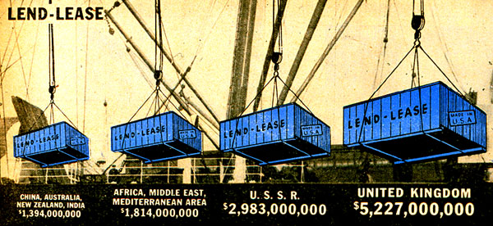
U. S. Lend-Lease Act 1941
Great Britain.........................$31 billion Soviet Union..........................$11 billion France..................................$3 billion China..................................$1.5 billion Other European......................$500 million South America.......................$400 million The amount totaled: $48,601,365,000

Slide 18
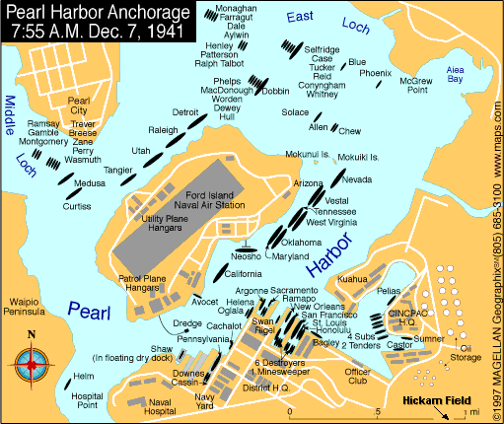
Germany’s & Axis powers response to America’s “Neutrality”
Germany, Japan and Italy planned to organized an attack on America’s pacific fleet. This would pull America in the war, and stop her material support of the Allies.
Japanese navy and naval pilots trained to destroy our pacific fleet at Pearl Harbor.

Slide 19
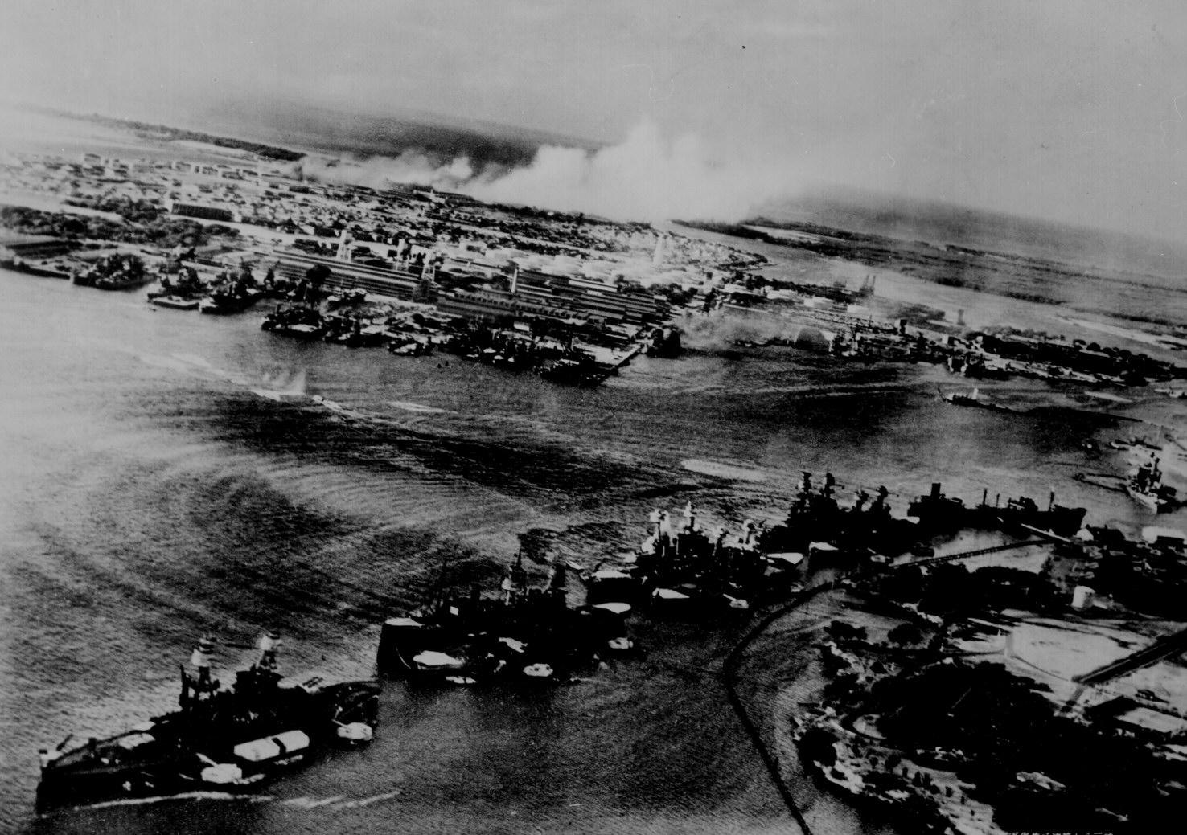
Pearl Harbor from the Cockpit of a Japanese Pilot

Slide 20
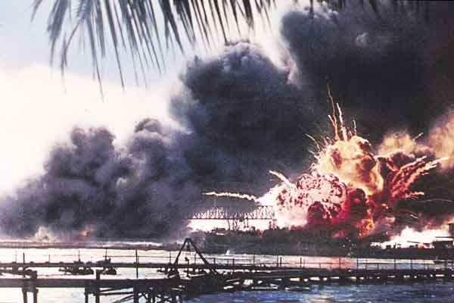
Pearl Harbor - Dec. 7, 1941
A date which will live in infamy!

Slide 21
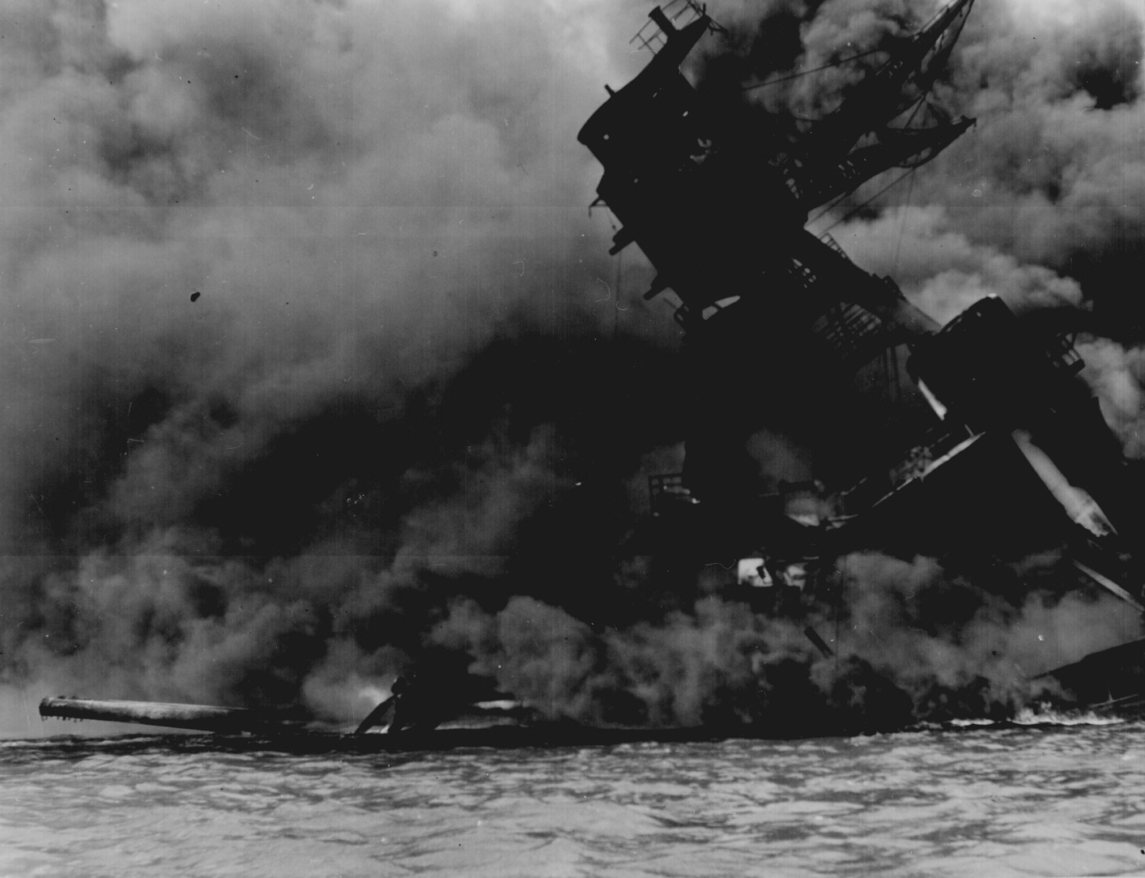
USS Arizona, Pearl Harbor

Slide 22
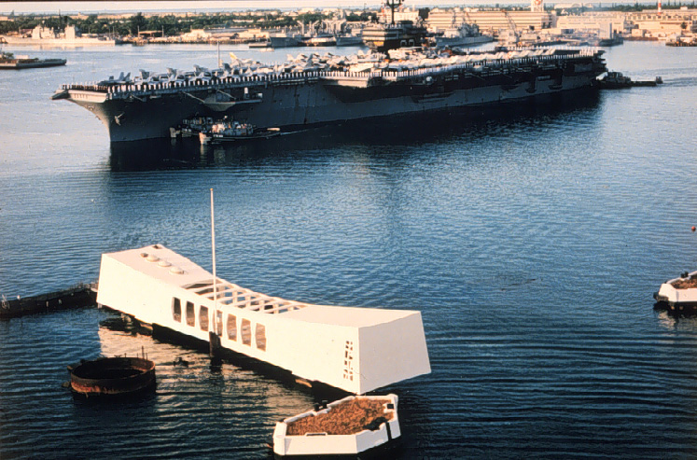
Pearl Harbor Memorial
2,887 Americans Dead!

Slide 23
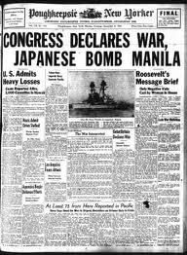
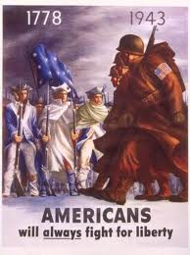
AMERICA DECLARES WAR!!!!! Americans put all their energies to fight this war

Slide 24
What was Happening in the US during the War
How is the families back home support the war effort?
How did the war effect life at Home?

Slide 25
Vocabulary
Rationing
Internment

Slide 26
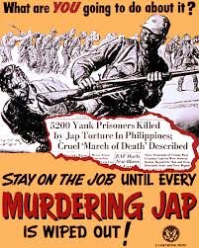
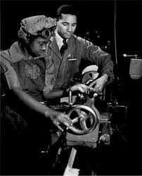
After the Surprise attack at Pearl Harbor…
The US had to build up its military.
Industry quickly converted its output from consumer to military goods. The war quickly ended the Great Depression. Millions of jobs opened up in factories especially for minorities workers.

Slide 27
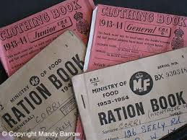
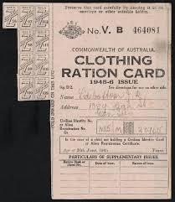
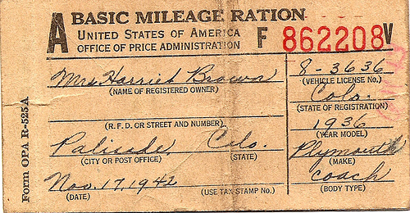
The government imposed rationing. Americans were issued ration coupons to purchase coffee, sugar, meat, shoes, gasoline, tires, and many other goods.

Slide 28
Men went off to fight, Women……
To work the jobs the men left in the factories.

Slide 29
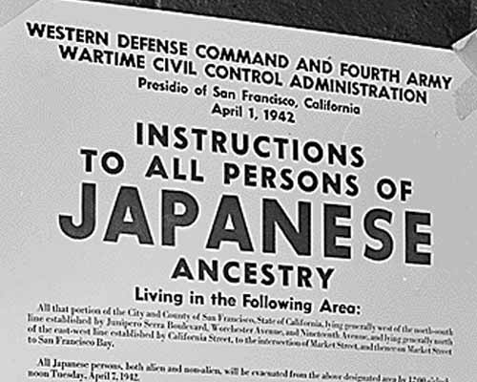
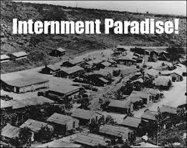
Japanese Internment
After the Japanese attack on Pearl Harbor, the majority of Japanese Americans lived in Hawaii and the west coast. People feared that the Japanese would act as spies
These fears, lead the government to the order that all Japanese Americans must be interned.

Slide 30
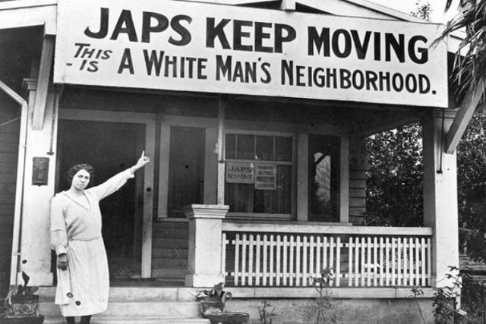
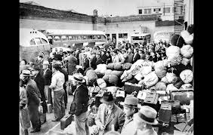

Slide 31
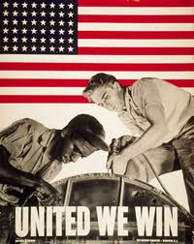
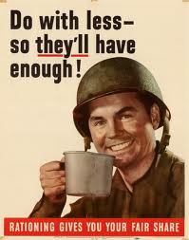
War effort at Home
The whole country supported the efforts needed to support the military and win the war.

Slide 32
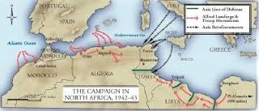
How will the Allies free Europe?
Germany assisted Italy in conquering North Africa
General Rommel was Hitler’s best general in Africa….known as the Desert Fox.
Allies goal was to take Africa then move up the boot of Italy 1943
US troops first fought in North Africa, then they invaded Italy. This was happening while the Allies were planning D-Day.

Slide 33
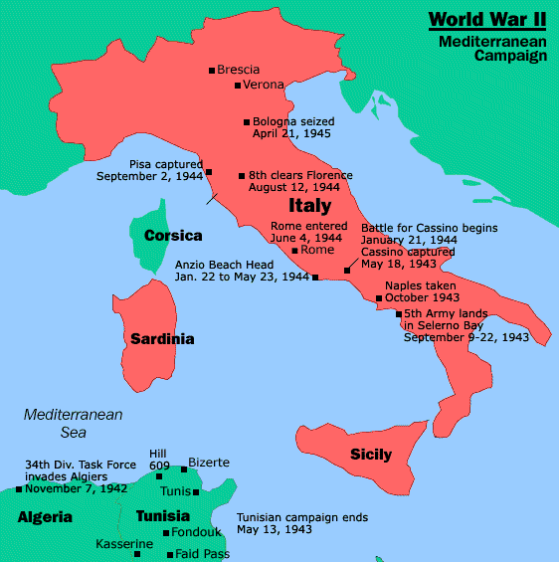
The Italian Campaign [“Operation Torch”]
Allies assault weakest Axis area - North Africa - Nov. 42-May 43
George S. Patton leads American troops.

Slide 34
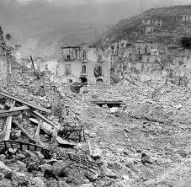
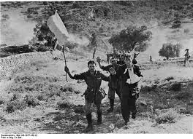
Patton conquers Italy
The town of Cassino, Italy. Major intense battle for the Americans, who held on!
African Americans in Italy
Germans surrendering in Italy

Slide 35
Italy falls
Mussolini & His Mistress, Claretta Petacci Are Hung in Milan, 1945

Slide 36
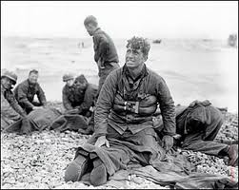
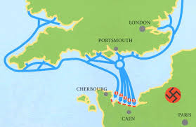
Now that Italy has surrendered……
Allies look at Europe and have to decide how to take Germany.
America and England decide to plan to invade Europe along the coast of France.

Slide 37
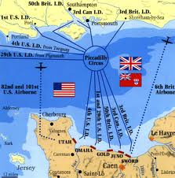
Invasion of Europe
American General Eisenhower and English General Montgomery planning the invasion of Europe.
This is a map of the coast of England and the prospective landing places for the Allies landing on the European continent. June 6, 1944

Slide 38
European Invasion—D-DAY
Combined troops from England, USA, planned and trained to attack Europe along the coast of France.
Russian troops using American supplies to attack from the East.
D-Day, JUNE 6th 1944

Slide 39
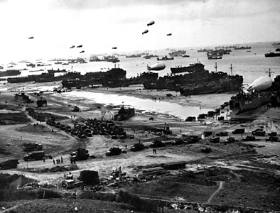
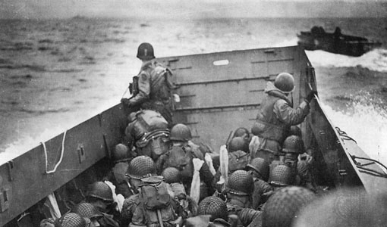
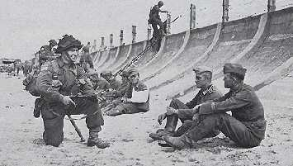
Normandy Landing (June 6, 1944)
German Prisoners
Higgins Landing Crafts
2500 Americans die on Omaha beach

Slide 40
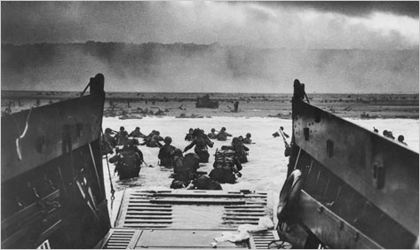
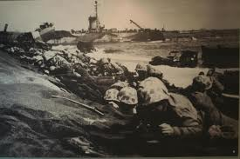
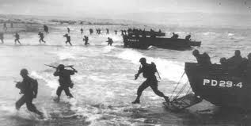

Slide 41
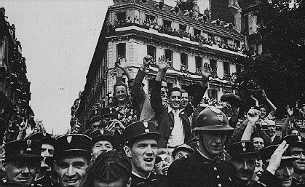
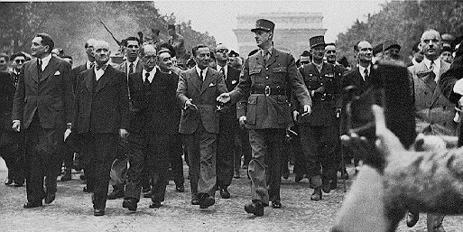
Allies push through Europe towards Germany
The Allies first reach the city of Paris and liberate it from the Germans
French leader , Charles De Gaulle in Triumph!

Slide 42
U. S. Troops in Paris, 1944

Slide 43
French women who collaborated with the Nazis
were captured by the French and publically humiliated

Slide 44
European Theater of Operations
The Mediterranean and North Africa | Part 1/4 | World War II in Colour and HD
This was the beginning of

Slide 45
After D-Day
The Russians advanced from the east as the other Allies attacked from the West.
Germany couldn’t handle a two front war on their own.
Gradually the German army was pushed back into the borders of Germany……After one last offense by the Germans.
Called the Battle of the Bulge.
It was the winter of 44-45. Americans were barely holding on stopping the German advance!!

Slide 46
December 1944
To January 1945
Hitler’s last offensive

Slide 47
BATTLE OF THE BULGE

Slide 48
Allies Advance through Europe

Slide 49
GERMANY ……END OF THE WAR V-E DAY

Slide 50
Hitler Commits Suicide April 30, 1945

Slide 51
V-E Day (May 8, 1945)

Slide 52
What is happening in the War in the Pacific?

