Slide 1
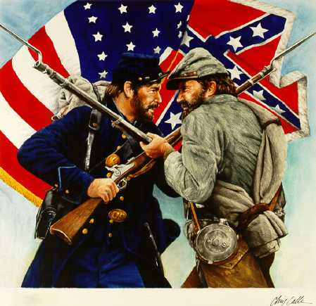
The Civil War

Slide 2
Vocabulary
Secession
Anaconda plan
Emancipation
Abolitionists
Appomattox Courthouse
Gettysburg
Habeas Corpus

Slide 3
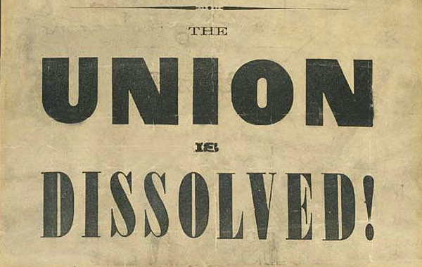
Secession
Following the election of Lincoln, SC formally seceded from the Union.
Secession was legal in the Constitution.
3 more states followed SC.

Slide 4
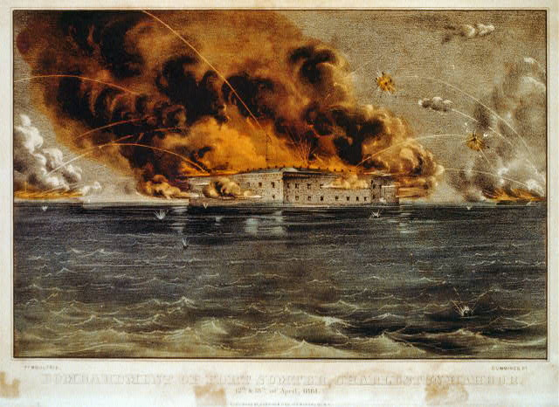
Battle of Fort Sumter
Confederate States demanded the Union Army abandon Ft. Sumter in Charleston Harbor.
It was considered a Confederate Fort.
Confederate Forces surrounded Ft. Sumter. It’s impossible for Union soldiers to receive supplies.
Notes:
2 Union deaths occurred in the Surrender ceremonies because of a gun explosion.
Lincolns call for volunteers caused 4 more States to secede.

Slide 5
First real test of Lincoln’s administration
April 12, 1861 Confederate forces open fire which lasted 36 hours.
Union agrees to evacuate.
Lincoln calls for 75,000 volunteers to join the Union army to end the rebellion in the South.
The call for volunteers cause 4 more states to secede.

Slide 6
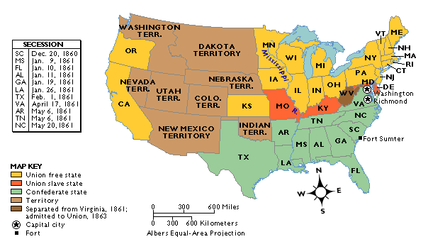
West Virginia was Created
The 50 western most counties in Virginia opposed slavery and secession and broke off from the state creating West Virginia, which remained in the Union.
Notes:
41st parallel. 60% voted for Lincoln
1st four states to secede cited reasons. GA said the Federal Gov. favored North over South in economic interests.
Cooperationist- did not want to secede until the south was united in secession.
Border states were states that did not secede-KY, MD, MO

Slide 7
North vs. South
Southern Advantages:
Northern Advantages
  Fighting on their own territory, they knew the land and
  were fighting for their homes, farms and way of life!
  The South had the most experienced military officers.
  110,000 out of 130,000 factories were in the North.
  Twice as much railroad track and farmland.
  Larger Population, larger pool of soldiers
  2/3 of the nation lived in States that remained in the Union
  1/3 of the South’s population was enslaved.
Notes:
2/3 of the nation lived in States that remained in the Union. Additionally,

Slide 8
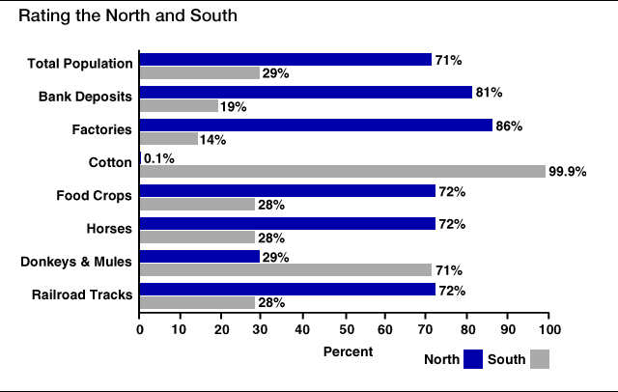
Rating the North & the South

Slide 9
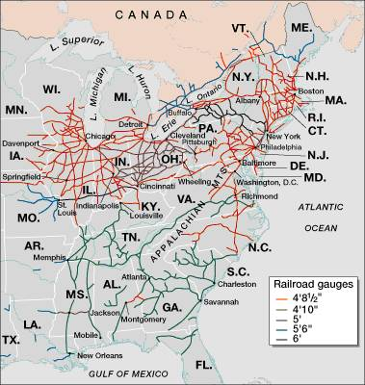
Railroad Lines, 1860

Slide 10
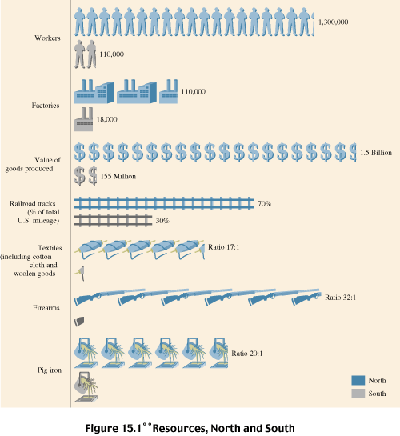
Resources: North & the South

Slide 11
The Union & Confederacy in 1861

Slide 12
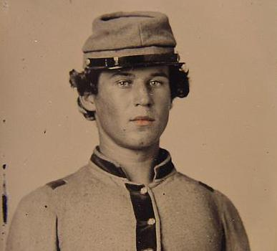
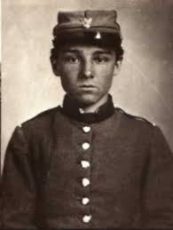
Americans fighting other Americans
Sons of a senator from Kentucky fought on different sides.
Mary Lincoln had 4 brothers who fought for the Confederacy.

Slide 13
What were the strategies of the
North and South?

Slide 14
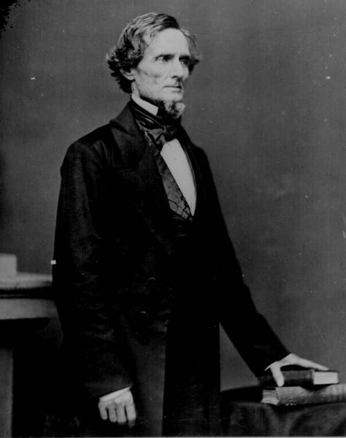
The Leader of the Confederacy
Southern Strategy: To hold and aggressively
defend the Confederate States.
Pres. Jefferson Davis

Slide 15
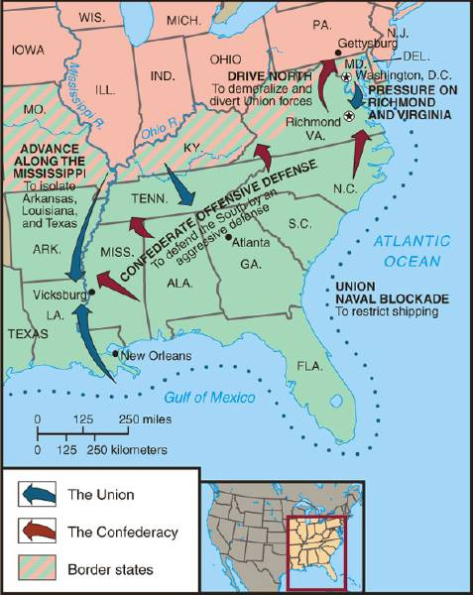
the North’s Civil War Strategy:“Anaconda” Plan Surround and starve out the south
Notes:
Cut off Mississippi River.
South just had to defend until North got tired of fighting.
General Winfield Scott

Slide 16
Important battles at the beginning of the Civil War
Ft. Sumter, April 1861
First Battle of Bull Run, July 1861
Shiloh, April 1862
Second Battle of Bull Run Aug 1862
Antietam, September 1862

Slide 17
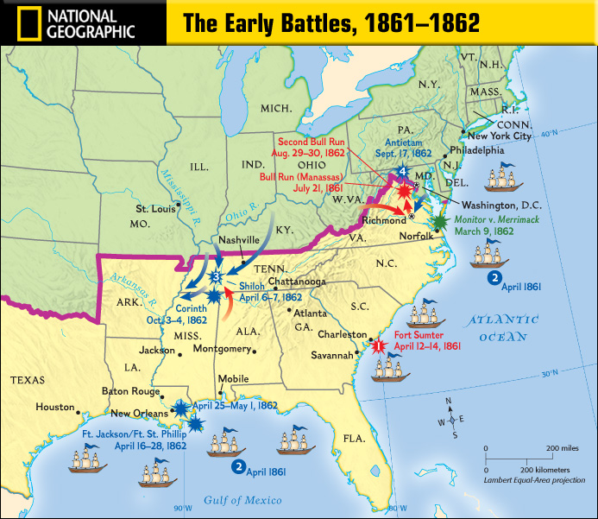
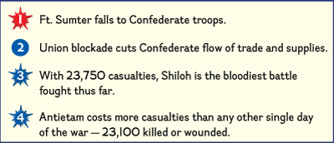
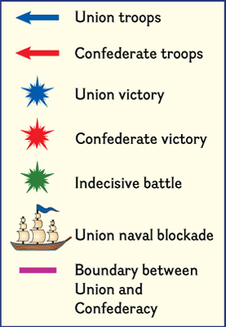

Slide 18
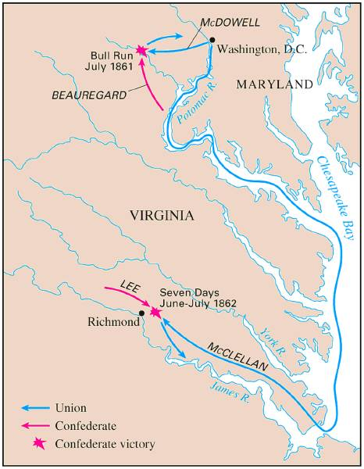
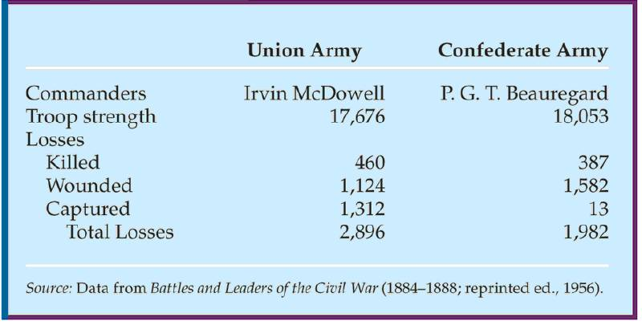
First Battle Bull Run
July, 1861
People came out especially from Wash. DC. to watch the first battle.
Most thought the South would easily be defeated and the War soon over.
The South pushed the Northern army back to Washington DC.

Slide 19
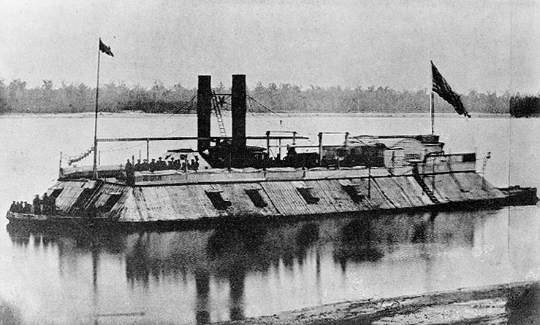
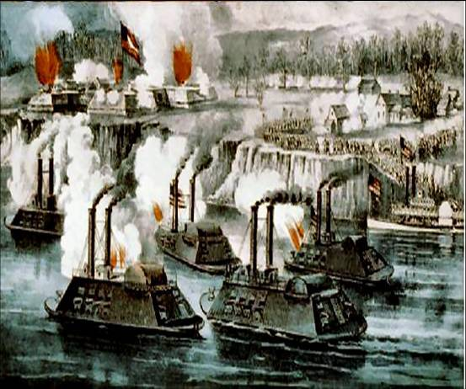
The Battle of the Ironclads, March, 1862
The Monitor vs. the Merrimac
These are ships that are covered in sheets of iron. Cannon balls bounced off the iron sides of the ships.

Slide 20
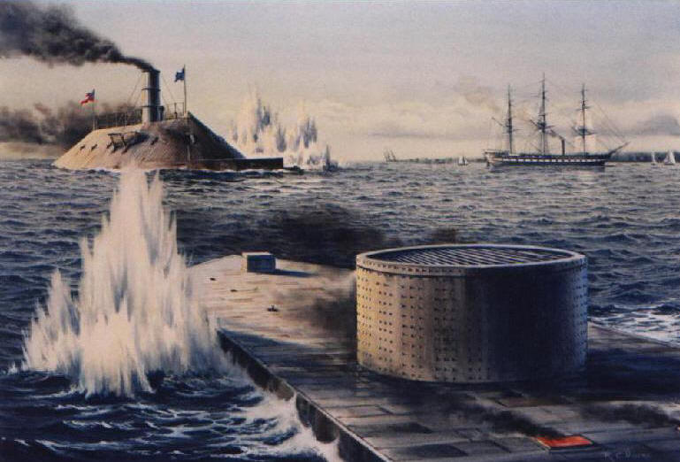
First metal ships in world!

Slide 21
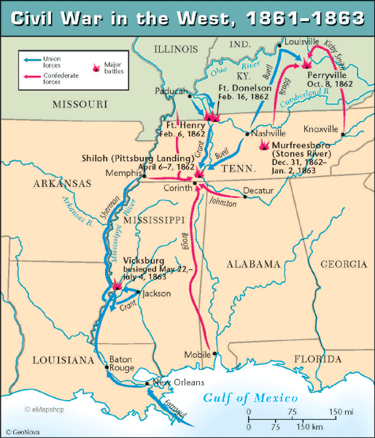
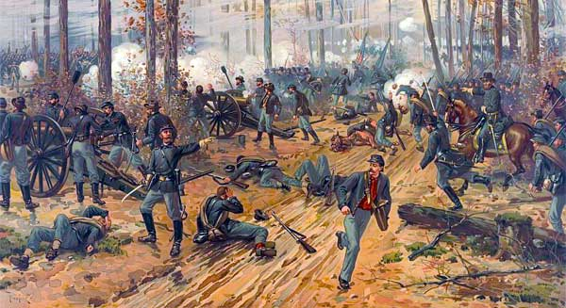
Union Gen. Grant controlled most of Mississippi River. South attacked at
Shiloh.
Battle of Shiloh:
11,000 casualties North 13,000 South.
South lost a major railroad center.
After Shiloh, Union forces captured New Orleans. By summer entire Mississippi River was under Union control.
Battle of Shiloh, April 1863
Notes:
In the West Ulysses Grant had gained control of most of the Mississippi River after capturing Fort Henry on the Tennessee and Fort Donnellson on the Cumberland River.
Corinth Mississippi was an important Railroad Center and Grant advanced towards it. Confederate General Albert Johnson gave a surprise attach before they could make it.
Battle of Shiloh had 11,000 casualties for the North and 13,000 for the South. Forced Confederate Forces to leave the railroad center. Only a few weeks after the Battle of Shiloh, Union forces captured New Orleans and by summer the entire Mississippi River was under Union control.

Slide 22
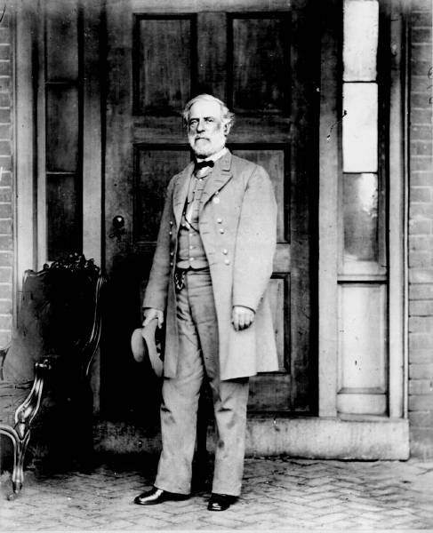
Robert E. Lee Southern General
After McClellan was defeated at Bull Run.
Lee believed that Richmond was not threatened. He decided to invade the North. Victory on Union soil would win support for the South in Europe & turn Northern public opinion against the War.-
Sept. 1862 Lee snuck his troops into Western Maryland.
Union officer found a sheet of paper with Lee’s battle plan.
The Union army met Lee at Antietam.
Notes:
-After McClellan was defeated, Lee believed that Richmond was no longer threatened. He decided to take a risk and invade the North. He thought that a victory on Union soil would help win support for the South in Europe and turn Northern public opinion against the War.
-Sept. 1862 Lee snuck his troops into Western Maryland.
-Union officer found a sheet of paper with Lee’s battle plan.

Slide 23
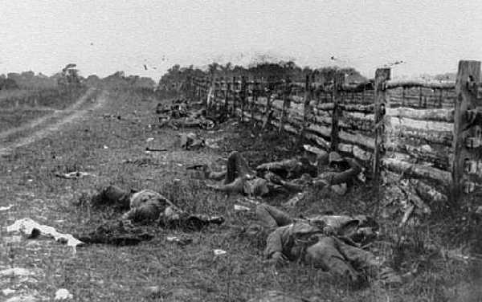
Antietam: September 17, 1862
Antietam 26,000 casualties (12,000 North, 14,000 South) Bloodiest day of Civil War.
No clear winner, but South ordered retreat. It is considered a Union Victory. Lincoln was upset because Gen. McClellan. Did not pursue Lee.
Notes:
Bloodiest day of Civil War.
No clear winner, but South ordered retreat so it is considered a Union Victory.
Lincoln was upset because Gen. MC. Did not pursue Lee.

Slide 24
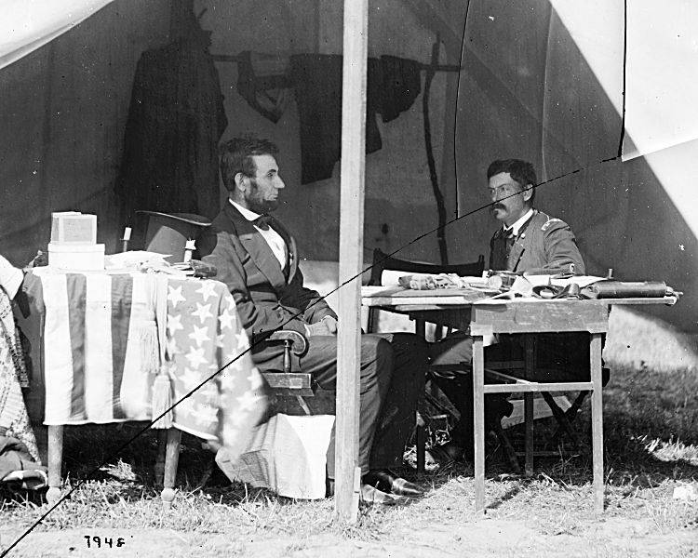
After Bull Run Lincoln replaced McDowell with McClellan. 7 months he trained 100,000 soldiers.
Advancing, they outnumbered 15,000 Southern troops. McClellan was so cautious he wanted more troops. He
retreated to wait.
This gave Confederates more time to build up their troops.
May 31, Confederates stopped McClellan's advances on Richmond. Richmond was the Southern capital. Taking it would have ended the war!
Lincoln and McClellan
Notes:
After Bull Run Lincoln replaced McDowell with McClellan. 7 months McClellan trained his Army.
Finally he moved 100,000 soldiers by boat to peninsula. They outnumbered the 15,000 troops that guarded the peninsula but McClellan was so cautious that he still didn’t have as many troops as he wanted because Lincoln had kept 37,000 troops behind so he retreated to wait for new troops. This gave the Confederates more time to build up their guard. On May 31, Confederates stopped McClellan's advances on Richmond.

Slide 25
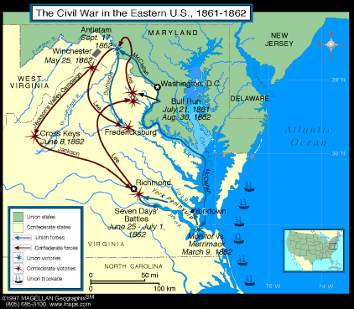
Early stages in the war the South won most of the battles
Why the South had more success?
Excellence Leadership!!!!
Robert E. Lee
Even though the
North had a larger
Army, more sup-
Plies, better trans-
portation

Slide 26
Divisions were not only between north and South but also within North and south
In the South:
States that had the strongest opposition to the war, Georgia and North
Carolina
In the North:
Many were against the Emancipation Proclamation
Both sides tried to discourage the war by encouraging soldiers to dessert.
To deal with the many who were against the war, both President Lincoln and
The Confederate President suspended Habeas Corpus (the legal right of imprisoned persons to be brought to court to determine if they are being held
Legally). Result more than 13,000 people arrested and jailed without trials.

Slide 27
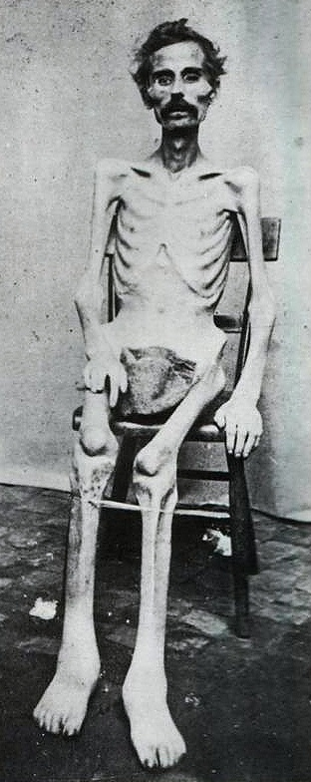
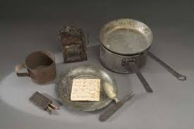
Soldiers Life
Soldiers spent ¾ of there time in camp
Trained for 10 hours a day
Meal of hard tack.
Camp conditions:
lack of clean water
diseases were rampant, most times soldiers too sick to fight
Prisoner of War Camps as many as 100 died a day usually from starvation or exposure from not having any housing.

Slide 28
Other Civil War effects
Draft law was pasted that required military service. By the end of
the war the ages required to serve for the South was 17-50.
In both the North and South the wealthy could get out of serving.
South: You own more than 20 slaves
North: Pay 300 could get you out of service, (about a years salary)
For both sides if you had the money you could pay someone to serve
in your place.
War strained both economies, the North could handle it better. The
First income tax was levied, Inflation or a rise in the price of
Things went up 400% South suffered more from inflation. In the South
Shoes cost $18 in 1862 cost $800 in 1865
Nursing used to be mostly a male job, Civil War broke that norm and
Women began to dominate nursing.

Slide 29
My the end of 1862, which side was more successful?

Slide 30
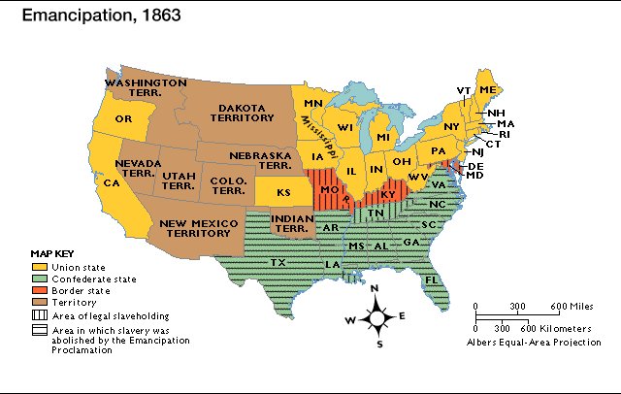
Emancipation in 1863- Freeing all slaves
Preservation of the Union meant everything to Lincoln. He realized abolishing slavery in the South would help do that. Emancipation makes this a war over slavery not preserving the Union, thus making it impossible for Britain to side with South. African Americans to want to fight to end slavery.
Notes:
Lincoln wanted to preserve the Union more than anything. But eventually he realized how much that abolishing slavery in the South would weaken the South.
-Very importantly emancipation ensured that Britain would not recognize the South’s independence. Ensuring that this was a war over slavery, made it impossible for Britain to side with South.
-Also caused African Americans to want to fight and rise up for battle.

Slide 31
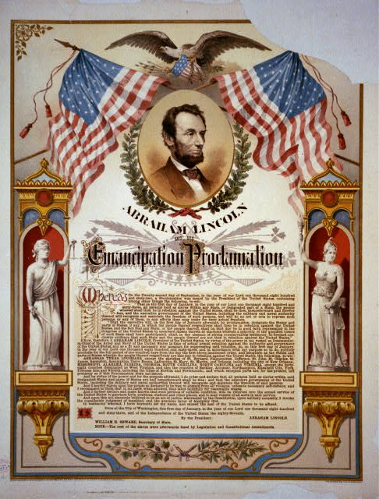
Emancipation Proclamation
It freed the slaves only in states that have seceded from the Union.
It did not free slaves in border states.

Slide 32
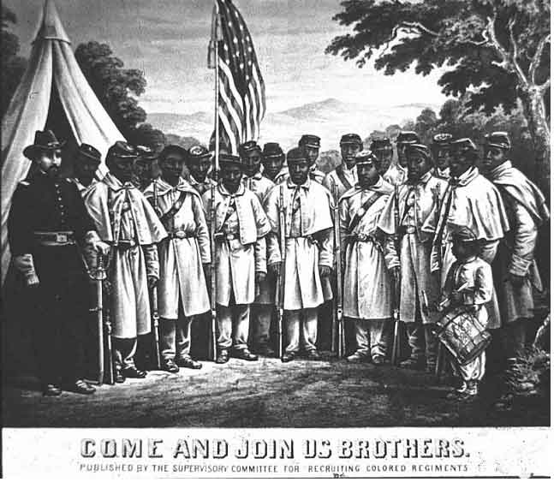
African-American Recruiting Poster

Slide 33
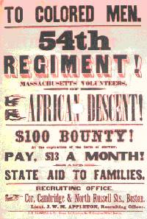
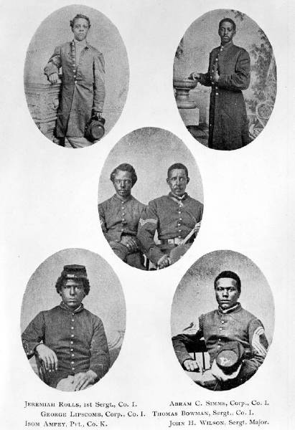
The Famous Black Regiment 54th Massachusetts

Slide 34
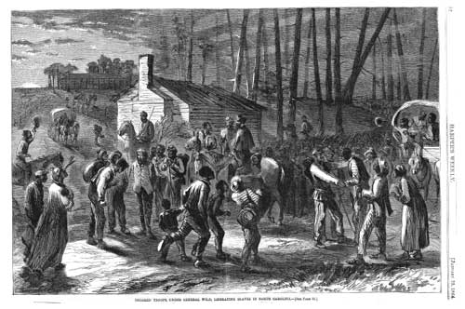
Black Troops Freeing Slaves

Slide 35
Emancipation Beginning of the End for the South 1863
The war continued to turn bad for the south.
By end of 1863 the North was pushing through the Southern States lead by General Sherman.
Sherman’s goal was to consume or destroy all enemy resources.

Slide 36
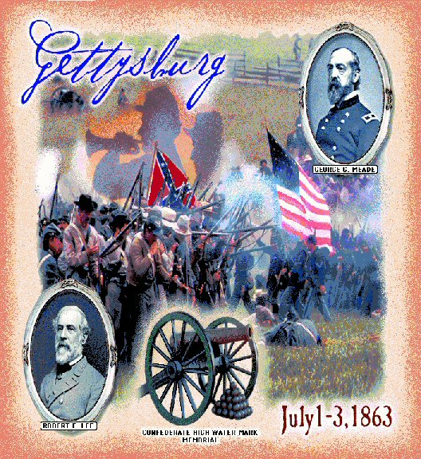

Slide 37
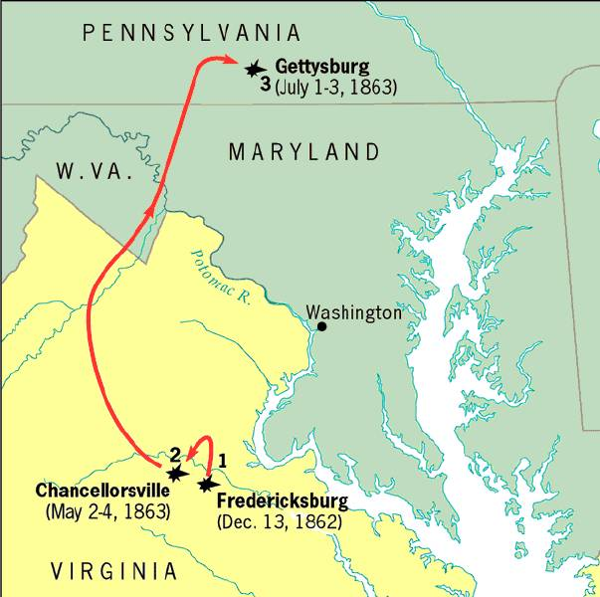
Gettysburg, July 1-3, 1863
With all the southern losses General Lee realized it was crucial to attack the North on its territory.
This would redirect fighting from southern territory to the north. Lee targets Gettysbutg PA. From there he intends to attack Wash. DC.
Southern Gen., Pickett led 15,000 Confed. troops across open fields where Union mowed them down= "Pickett’s Charge“ Over half of the troops died.
Confederated were defeated and retreated to Virginia.
Gettysburg is the largest battle. Over 100,000 people died in 3 days.

Slide 38
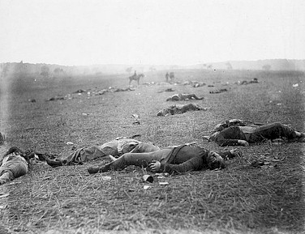
Gettysburg, July 1-3, 1863

Slide 39
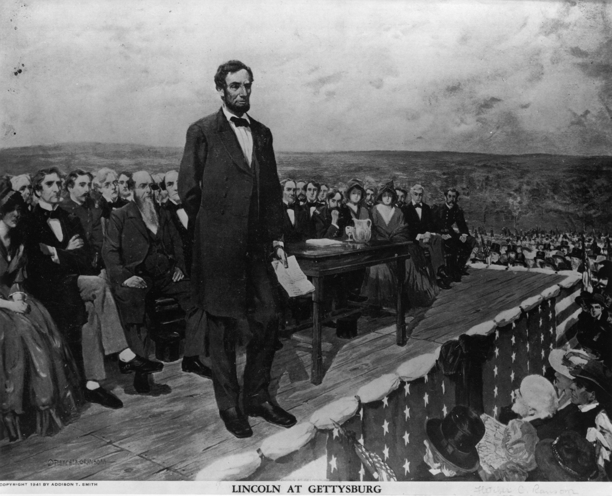
Gettysburg Address
Speech Lincoln gave to
dedicate a memorial
to those who died at
Gettysburg

Slide 40
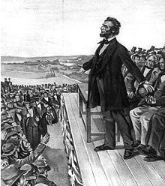
Gettysburg Address
that from these honored dead we take increased devotion to that cause for which they gave the last full measure of devotion -- that we here highly resolve that these dead shall not have died in vain -- that this nation, under God, shall have a new birth of freedom -- and that government of the people, by the people, for the people, shall not perish from the earth.
        Abe Lincoln

Slide 41
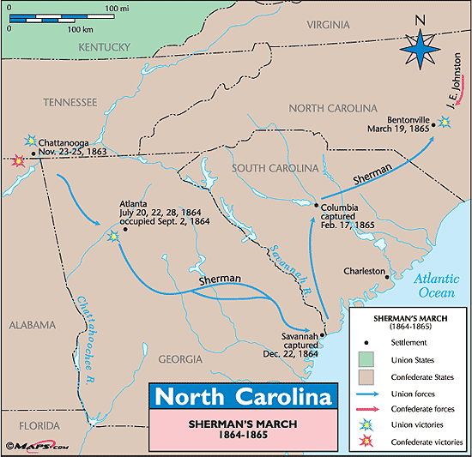
Sherman’s March to the Sea
Scorched Earth/Total War policy
Destroyed everything 50 miles of their march railroads, crops, homes, livestock, buildings
Intended to put pressure on Lee up North
Taking over Atlanta helped ensure the re-election of Lincoln and cripple the south more.
Notes:
-Total War
-Consume all the enemy’s resources
-Lincoln’s Christmas gift
-More pressure on Lee up North.

Slide 42
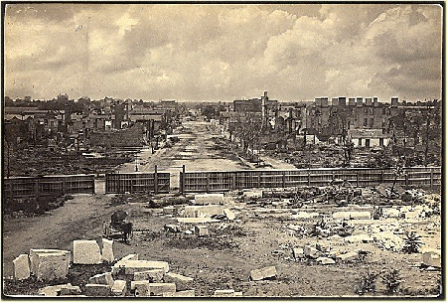
Atlanta Destroyed by Sherman

Slide 43
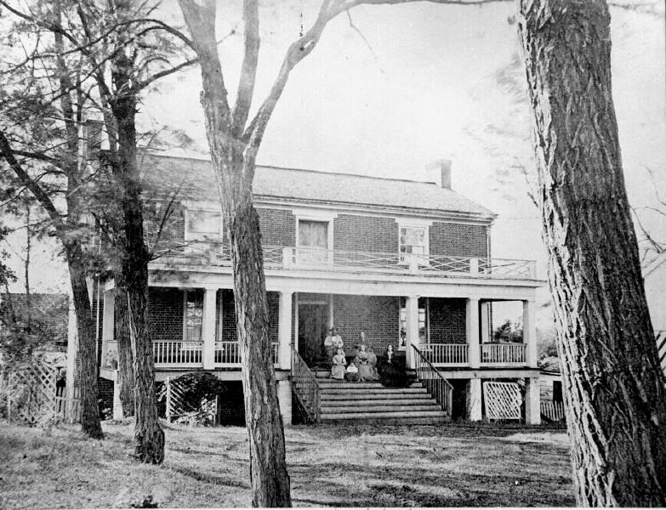
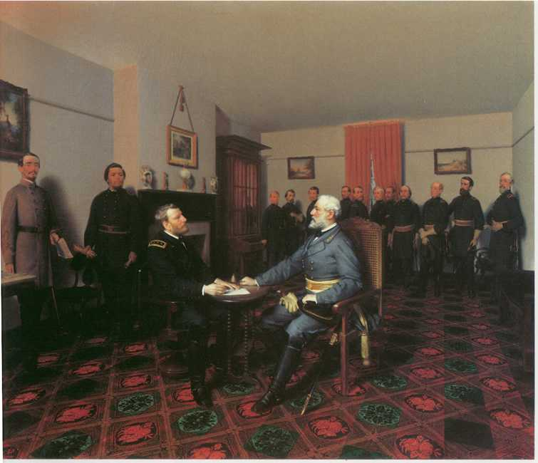
Surrender at Appomattox April, 1865
Richmond (the south’s capital) fell in April 1865
Lee fled Richmond. Grant caught Lee at Appomattox.
Lee surrendered with dignity Grant allowed rebel soldiers to go home
Lincoln announced there would be “malice toward none” – meaning the victorious north would not take revenge on the south
Lincoln assassinated five days later.

Slide 44
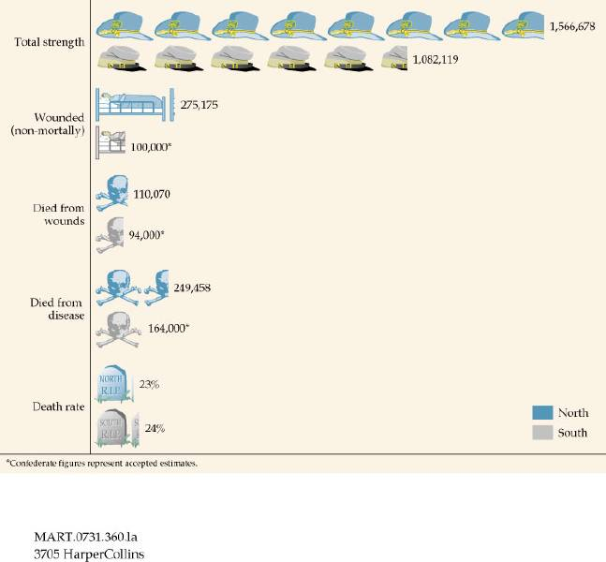
Casualties on Both Sides

Slide 45
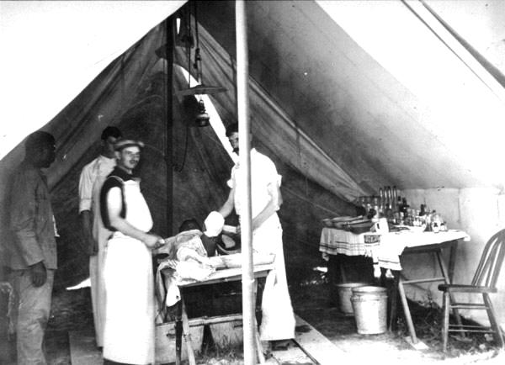
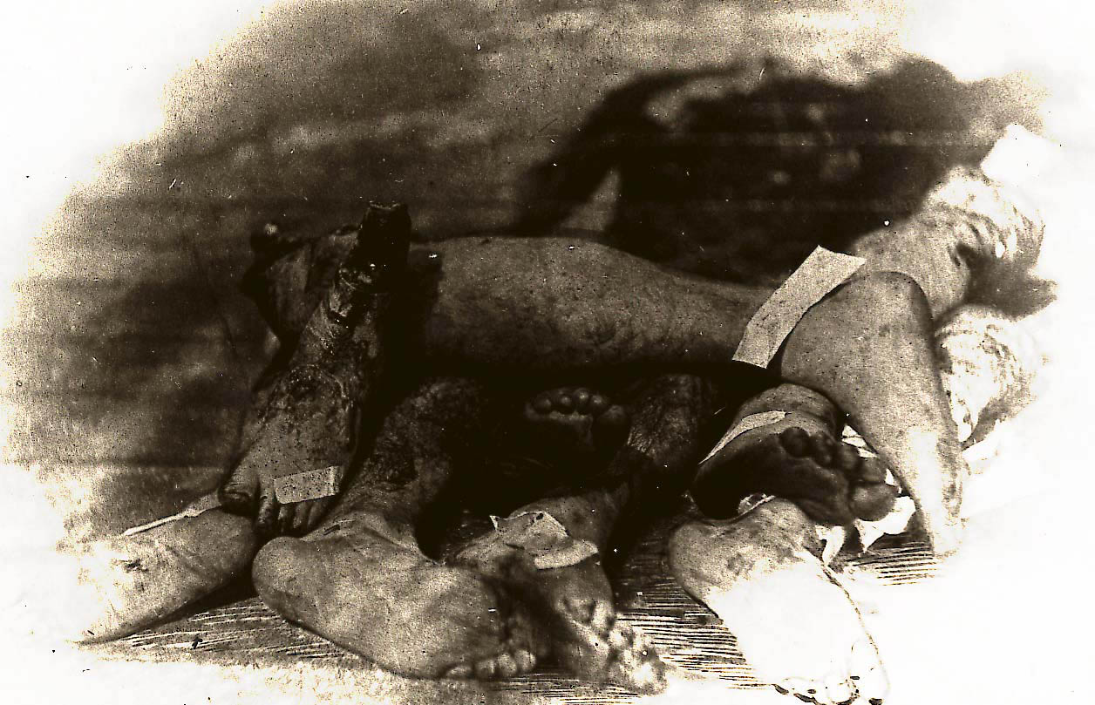
Many soldiers, died
from infection from
their wounds and
disease than from
the actual battle
field conflicts.
Surgical tent set up outside battle field
Limbs piled up from amputations

Slide 46
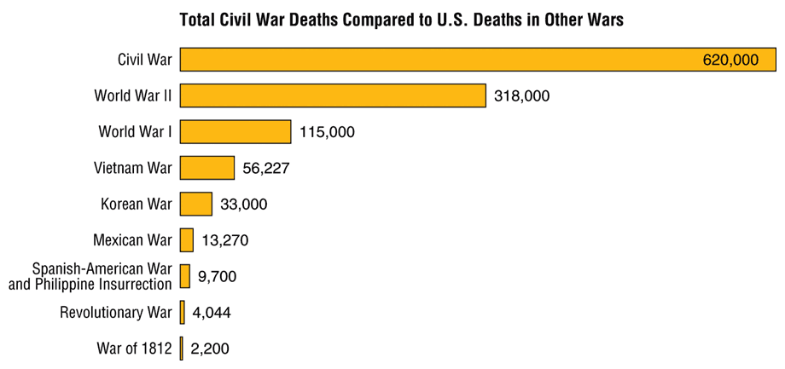
Civil War Casualties in Comparison to Other Wars

Slide 47
Important Civil War Battles & Events
Fort Sumter April 12, 1861
Bull Run #1 July 21, 1861
Naval Battle March 9, 1861
Shiloh April 6, 1862
New Orleans April 25, 1862
Antietam September 17, 1862
Emancipation Proclamation January 1, 1863
Gettysburg & Vicksburg July 1, 1863
Gettysburg Address November 19, 1863
“March to the Sea” Summer, 1864
Appomattox Court House April 9, 1865

Slide 48
Civil War in North Carolina?
Many North Carolinians fought in the early battles in Virginia.
Most Civil War battles were fought in Virginia.
There were many blockade runners from the North Carolina coast breaking through the North’s naval blockade
Bentonville NC was the last major battle between the North and South before the South surrendered

Slide 49
When the Union won the Civil War the big questions were:
  What should Southern states have to do to be readmitted to the Union?
  What should happen to southerners who participated in the war effort?
  What should happen to the newly emancipated slaves?

