Slide 2
Vocabulary
Harry Truman
Kamikaze

Slide 3
War in the Pacific
Totally different from the war in Europe
Japanese were fanatical about putting death and honor above everything else especially their own lives.
Fighting took place over vast area of ocean and water.
Fighting dominated by the use of carrier-based aircraft.
Island Hopping

Slide 4
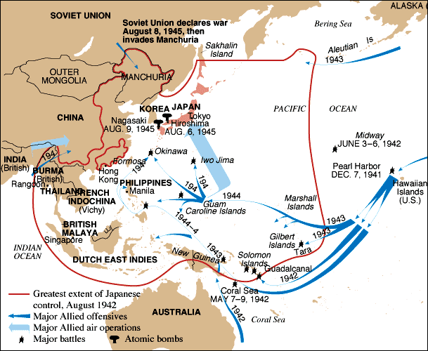
Pacific Theater of Operations

Slide 5
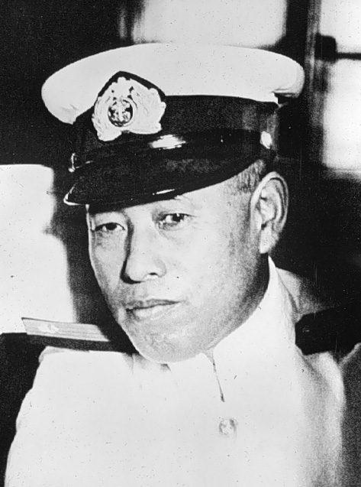
Admiral Isoroku Yamamoto
Leader of the Japanese
military

Slide 6
Just hours after Pearl Harbor, Japanese attacked bases on Guam and Wake Island.
The next day they began to bomb the Philippines.
US lost the Philippines to the Japanese and General MacArthur escaped to Australia

Slide 7
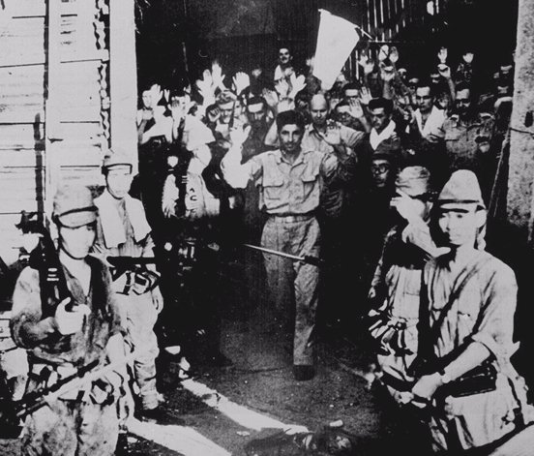
U.S. Surrenders the Philippines [March,1942]

Slide 9
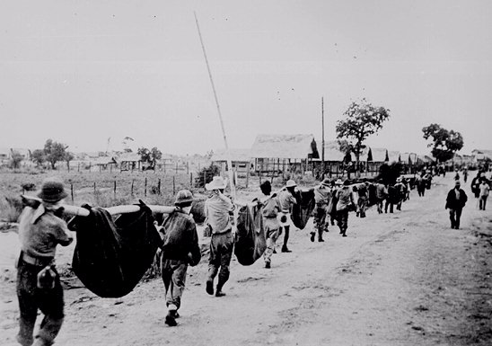
Bataan Death March: April, 1942
76,000 prisoners [12,000 Americans] Marched 60 miles in the blazing heat to POW camps in the Philippines most died on the trail.

Slide 10
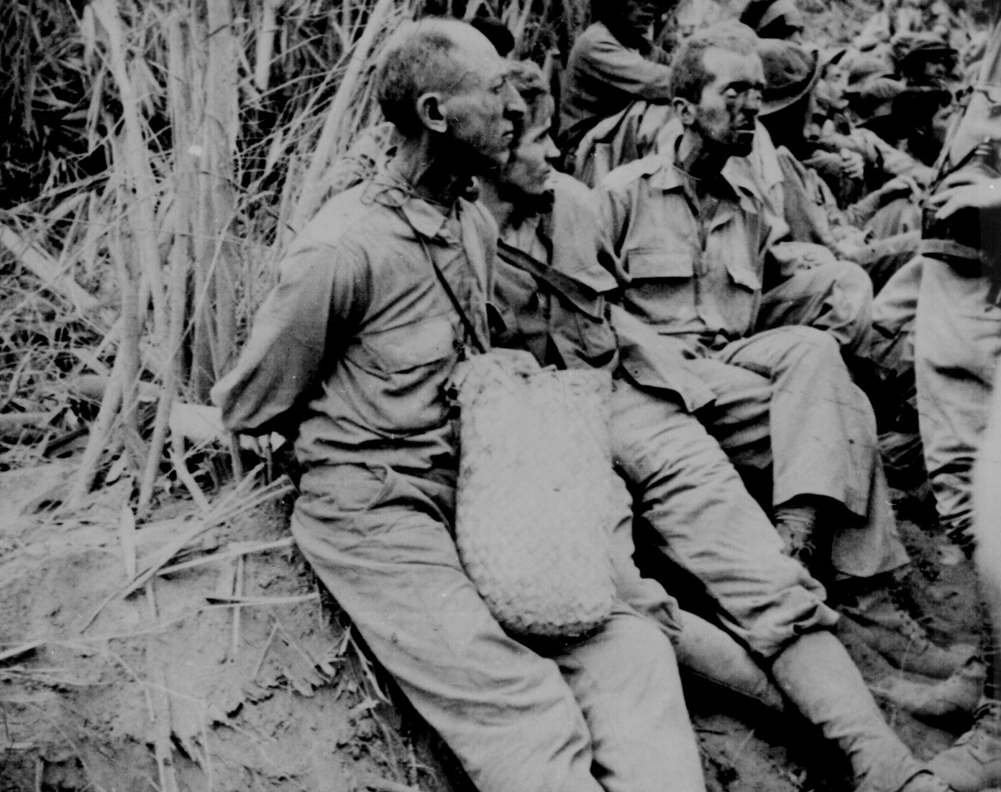
Bataan: British Soldiers captured at the surrender of the Philippines
A Liberated British POW

Slide 11
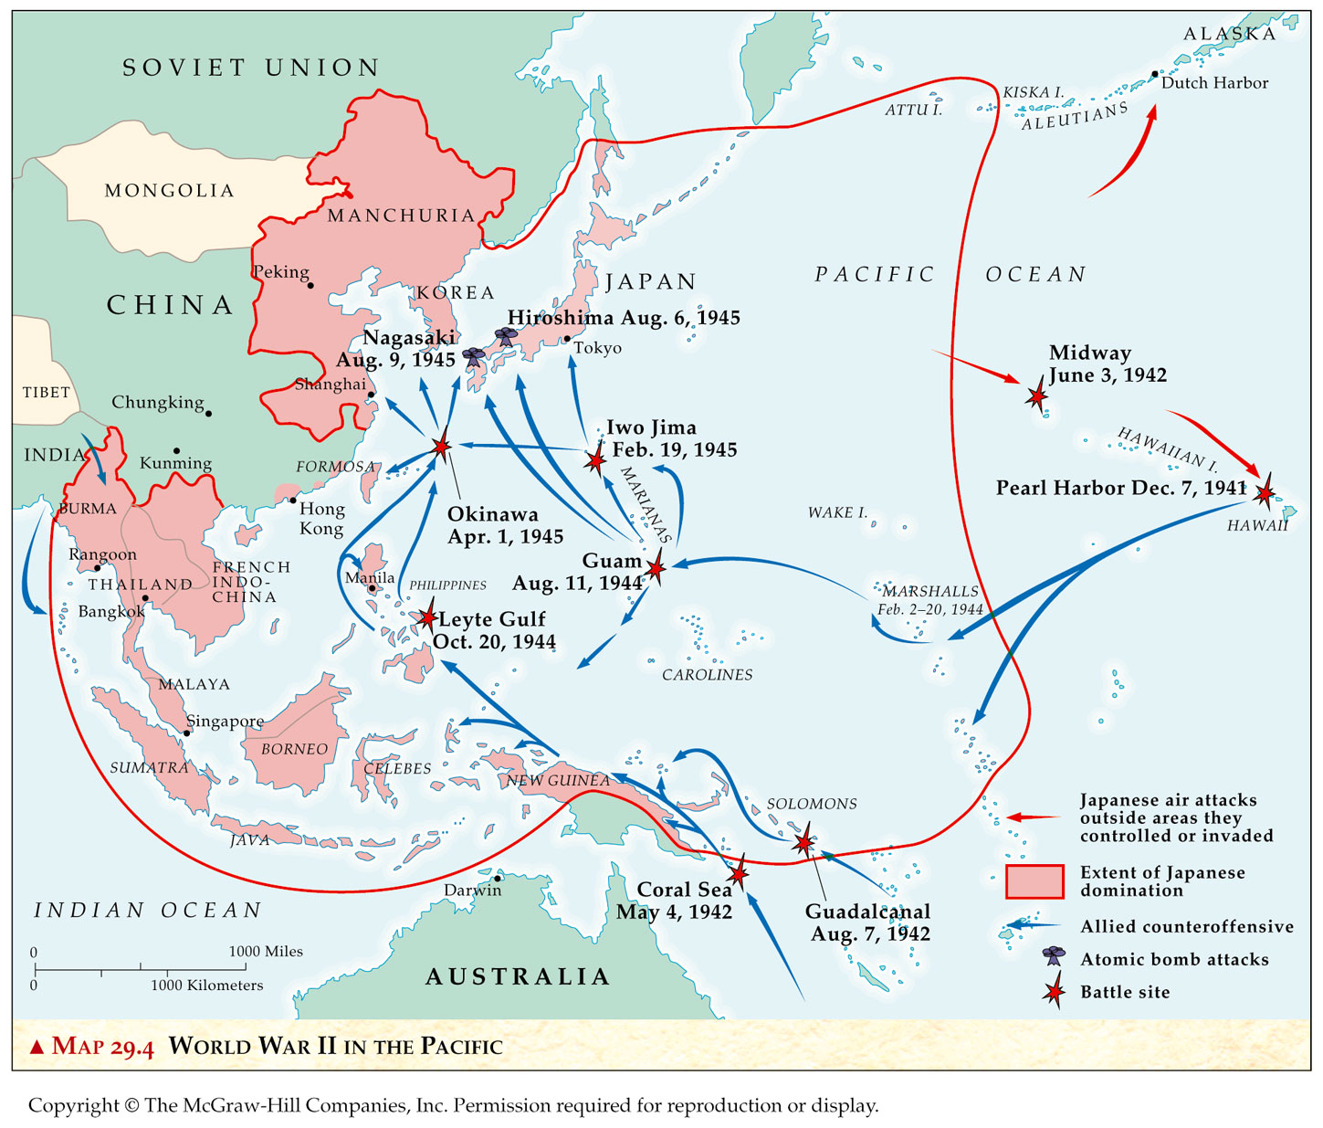
Allied Counter-Offensive:“Island-Hopping”. Japan conquered islands throughout the Pacific. Allied troops went from Island to Island to drive the Japanese out.

Slide 12
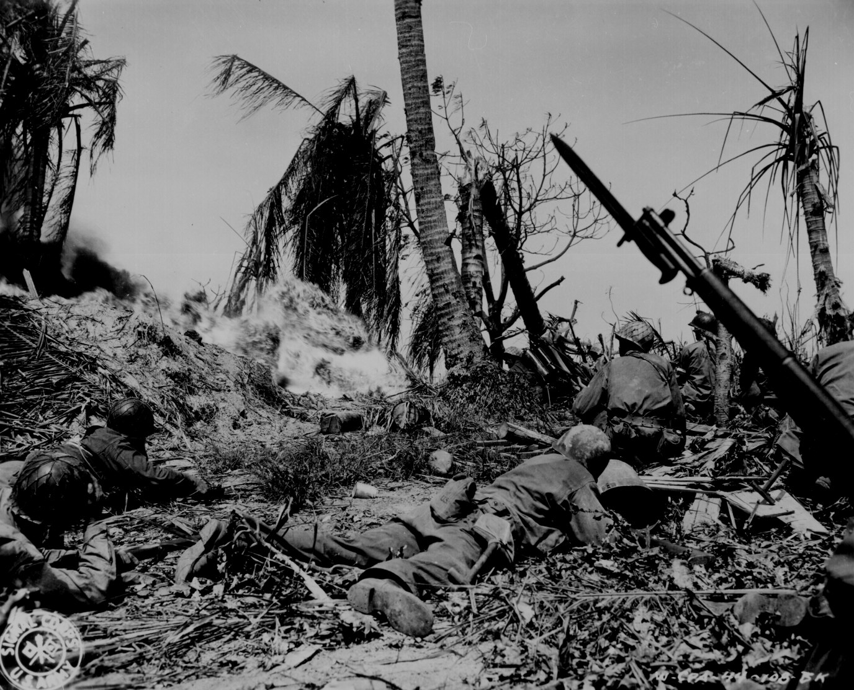
“Island-Hopping”: US Troops on Kwajalien Island. Because the Japanese would rather die with honor than live, the fighting on the islands were fierce!

Slide 13
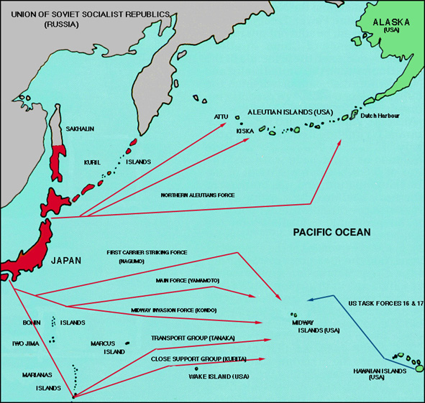
Battle of Midway Island: June 4-6, 1942
Japanese attacked Attu
Island in the Aleutian Islands to divert attention from Midway Island the real target.
America broke the Japanese transmission codes.
US ships made their way to Midway where they defeated the Japanese in the battle that changed the tide of the war!

Slide 14
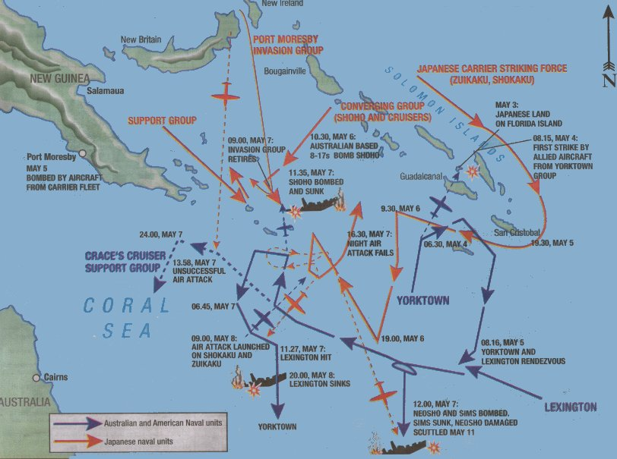
Battle of the Coral Sea: May 7-8, 1942
Battle between Japanese
ships and US aircraft carriers
Defeated the Japanese and prevented a invasion
of Australia

Slide 15
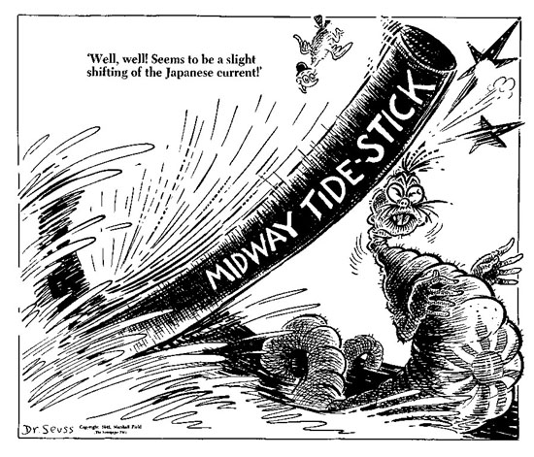
Battle of Midway Island: June 4-6, 1942. Dr. Seuss was very involved in war propaganda

Slide 16
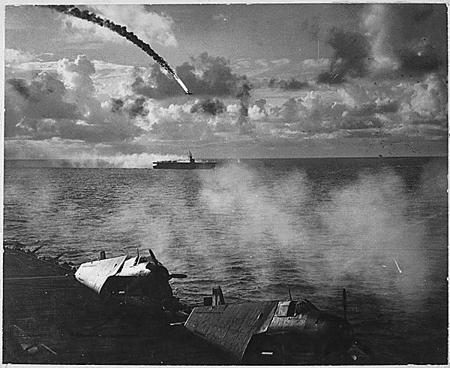
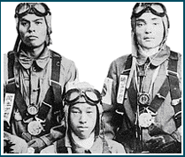
Japanese Kamikaze Planes: These were suicide bombers that would deliberately crash their planes into. Allied ships
Kamikaze Pilots

Slide 17
Letter from Kamikaze Pilot
My Dear Parents,
I have completed my letters. I have given my belongings to friends. Tomorrow I drink a ceremonial cup of Saki with my commander and then take off on my mission. Tomorrow I die for my Emperor and my country. I am, at the moment , very happy. In fact, these last few weeks have been among the happiest of my life . I have read, enjoyed the company of my friends, and composed poems to my Emperor. Everyone here has been wonderful. Yesterday, upon inspecting my planes, I noticed that the cockpit had been polished to a high shine. Upon inquiring of one of the crew why he had gone to such pains, he stated that he wanted my plane to serve as a coffin worthy of one about to give his life for his country. When I thanked him for his effort, he was moved to tears. So was I. Do not grieve for me, my parents. I am honored to play such an important role in the defense of our empire. I thank my superiors for giving me the opportunity to die in such in such glorious manner. What more can a Samurai ask for? I will die with your names on my lips. Say good by to my brothers and sisters for me.

Slide 18
War in the Pacific
As the war progressed in the Pacific, especially after the battle of Midway the tide of the war slowly turn on behalf o f the Allies, a major win was the retaking of the Philippines.

Slide 19
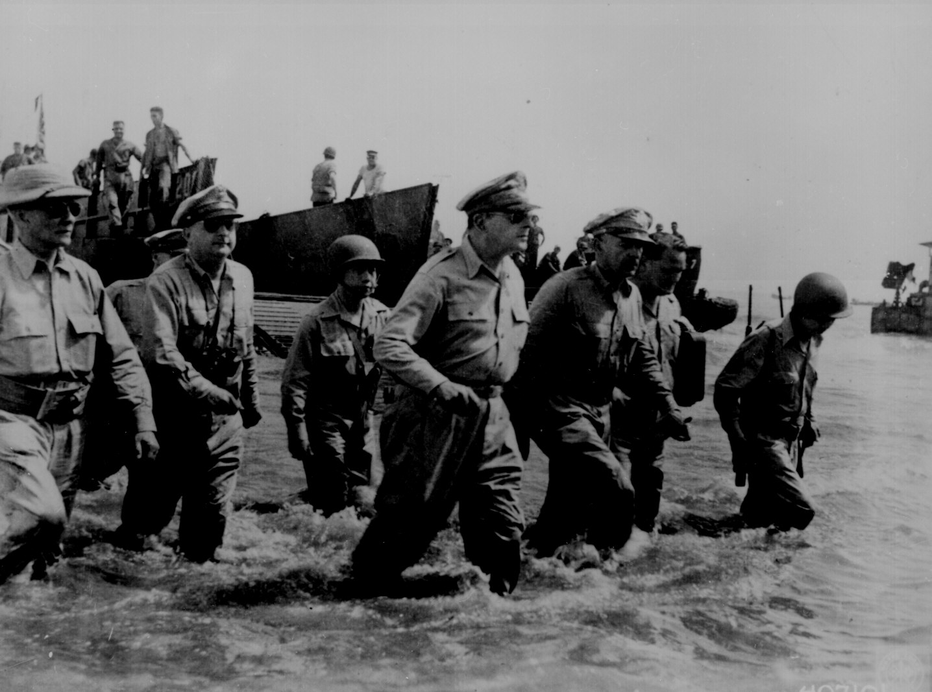
Gen. MacArthur “Returns” to the Philippines! [1944]

Slide 20
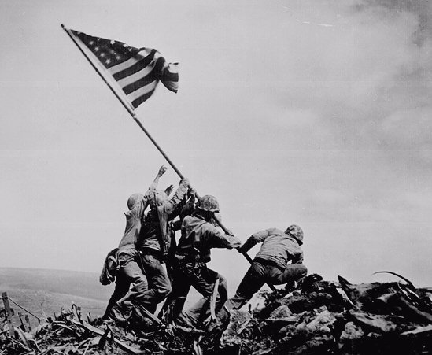
US Marines on Mt. Surbachi, Iwo Jima [Feb. 19, 1945] This iconic photo is one of the memorials we will see when we go to Washington DC.

Slide 21
War is partially over Germany surrenders
During the years the United States were in the war, we were doing research on developing a superior weapon.
This research was called the Manhattan Project. We were developing a atomic bomb.

Slide 22
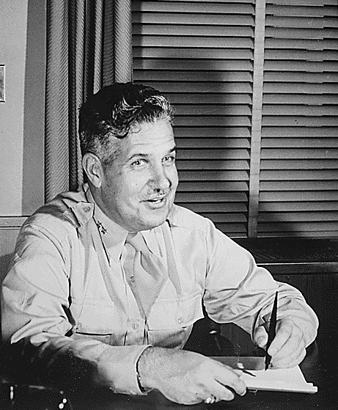
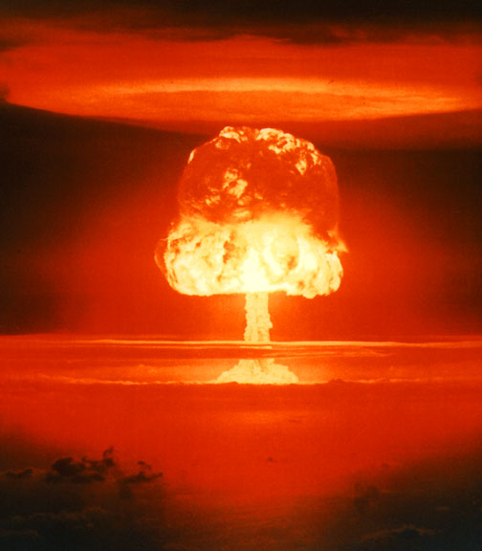
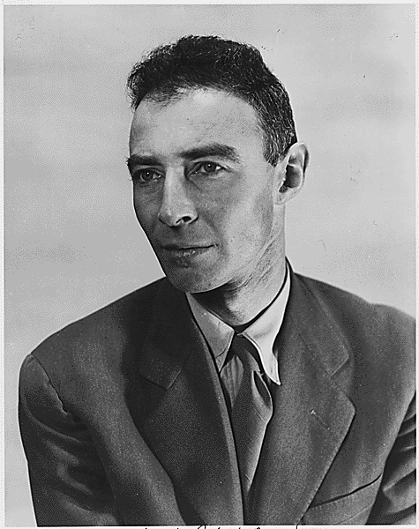
The Manhattan Project: Los Alamos, NM
Major General Lesley R. Groves
I am death, the shattered of worlds!
Dr. Robert Oppenheimer

Slide 23
War in the Pacific
President Roosevelt died in April 1945.(In May Germany surrendered. President Truman, (Roosevelt’s vice president) had to decide. whether to use this new type of bomb.
He knew that if he fought traditional war America could lose hundred of thousands soldiers in trying to capture Japan. He also knew the dropping an Atomic bomb would provide destruction never yet seen by one bomb.
Truman decides to drop the bomb!!!!!!!!!!

Slide 24
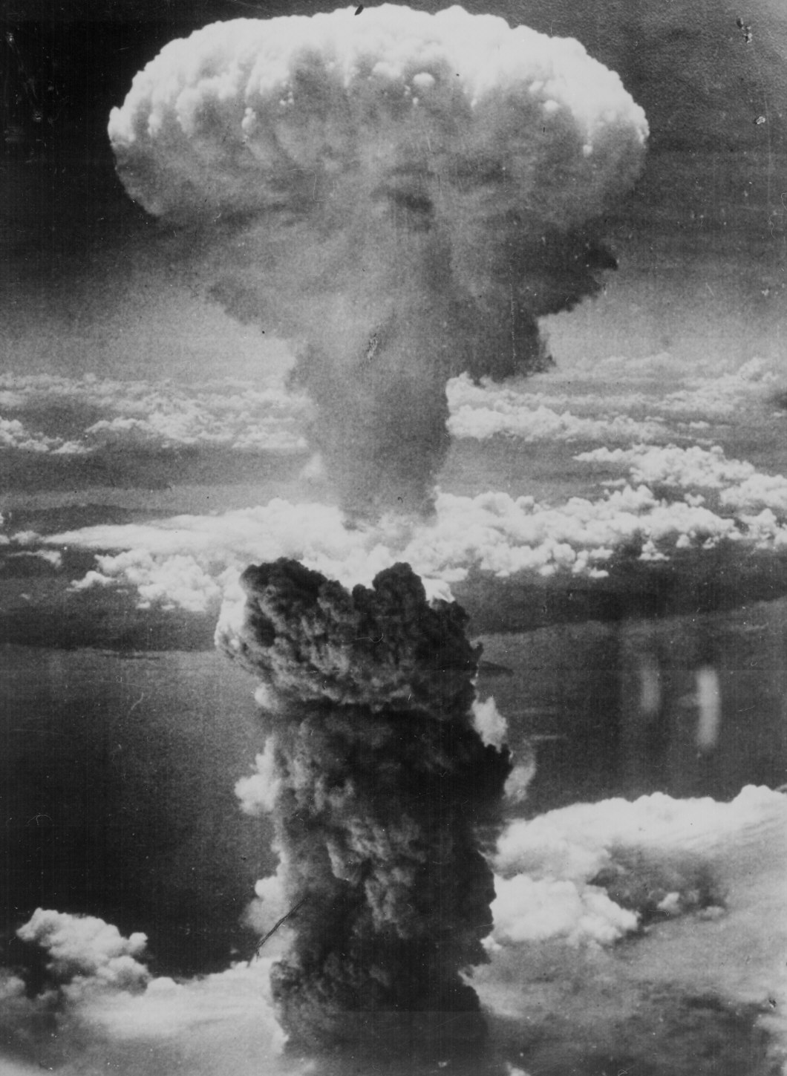
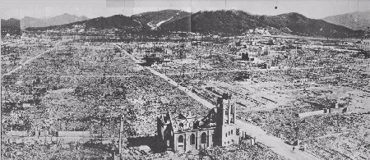
Hiroshima – August 6, 1945
70,000 killed immediately.
48,000 buildings destroyed.
100,000s died of radiation poisoning & cancer later.
Japan still did not surrender……SO

Slide 25
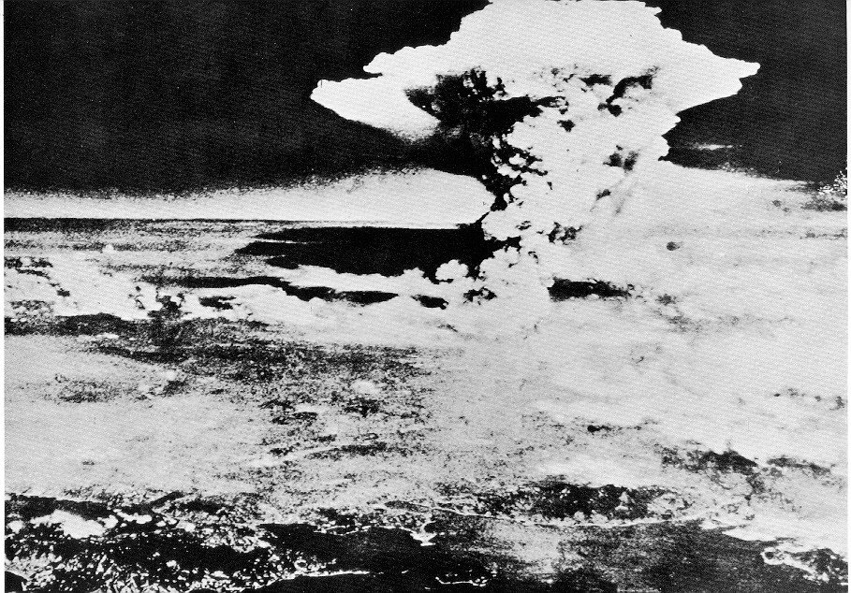
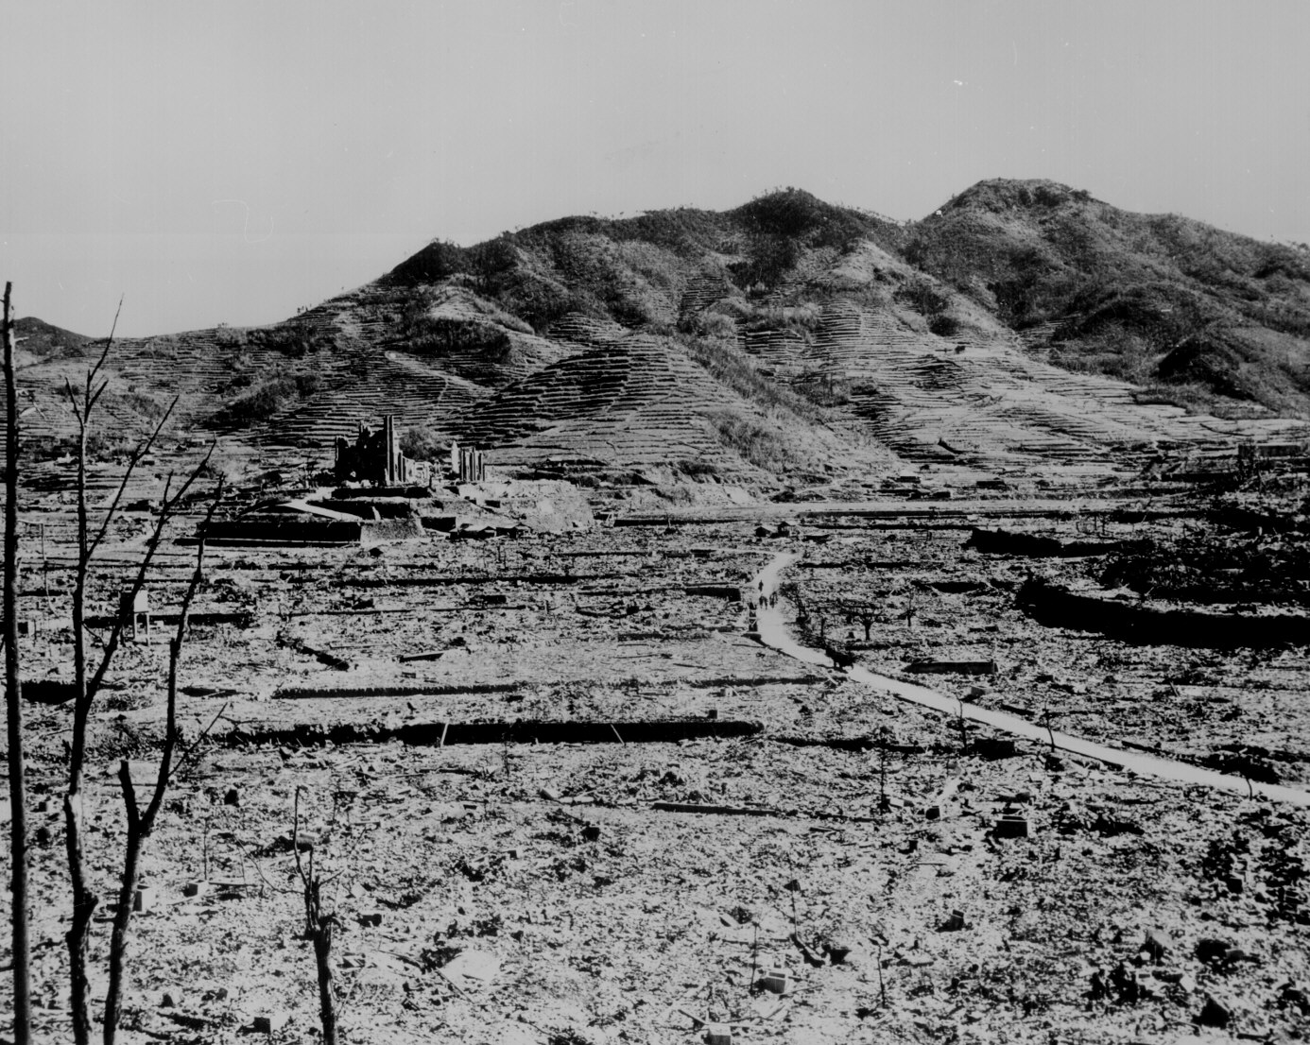
President Truman order the dropping of a second bomb on Nagasaki – August 9, 1945
40,000 killed immediately.
60,000 injured.
100,000s died of radiation poisoning & cancer later.

Slide 26
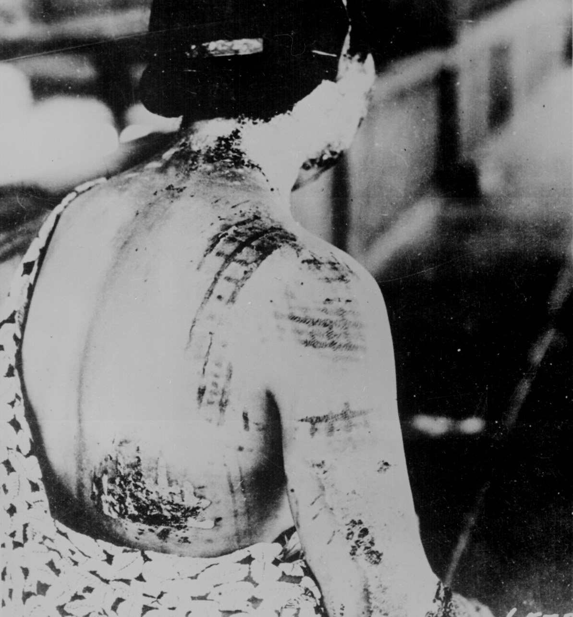
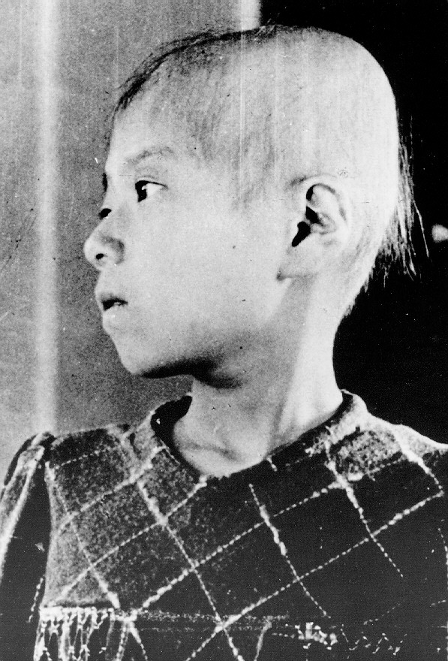
Japanese A-Bomb Survivors
Radiation Burns, Child’s hair falls out

Slide 27
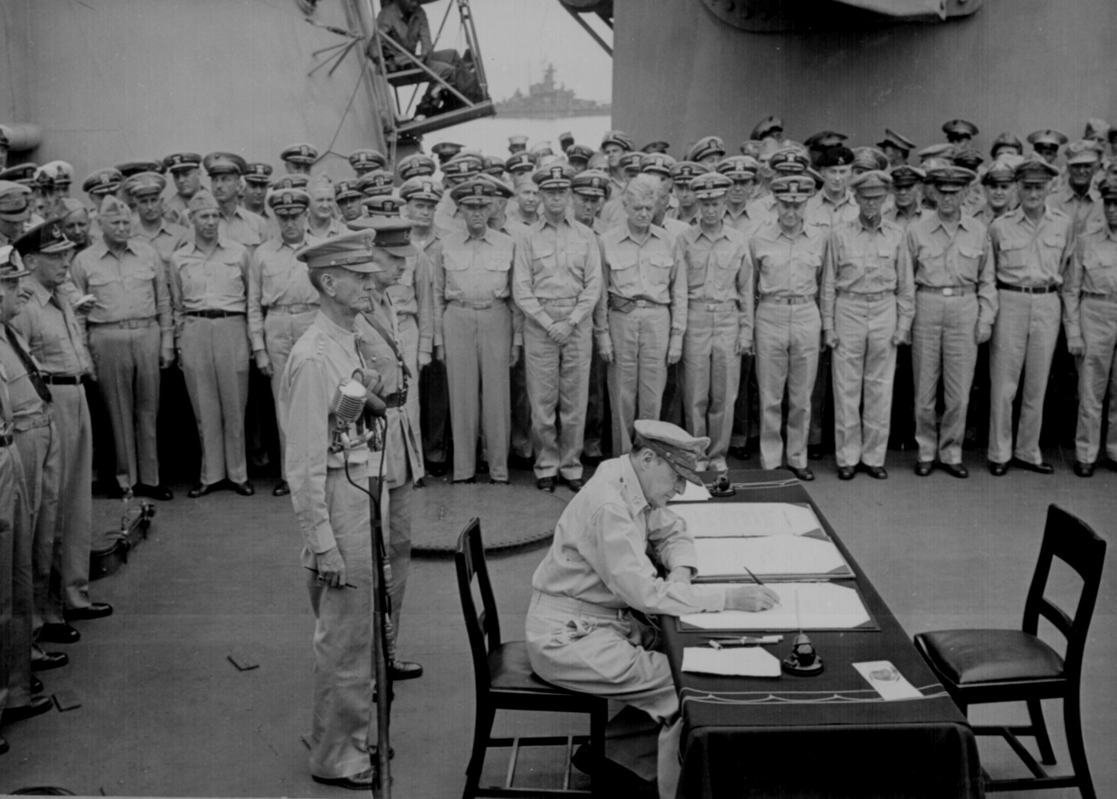
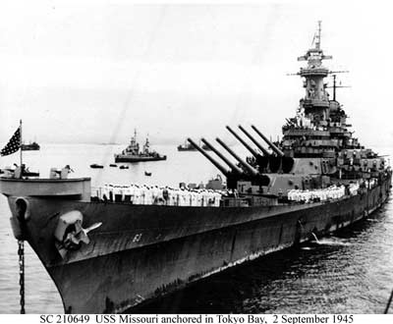
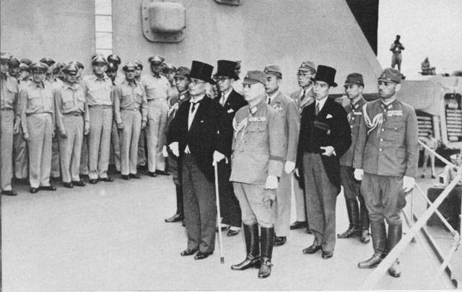
V-J day. Japans surrenders after the 2nd bomb dropped

Slide 28
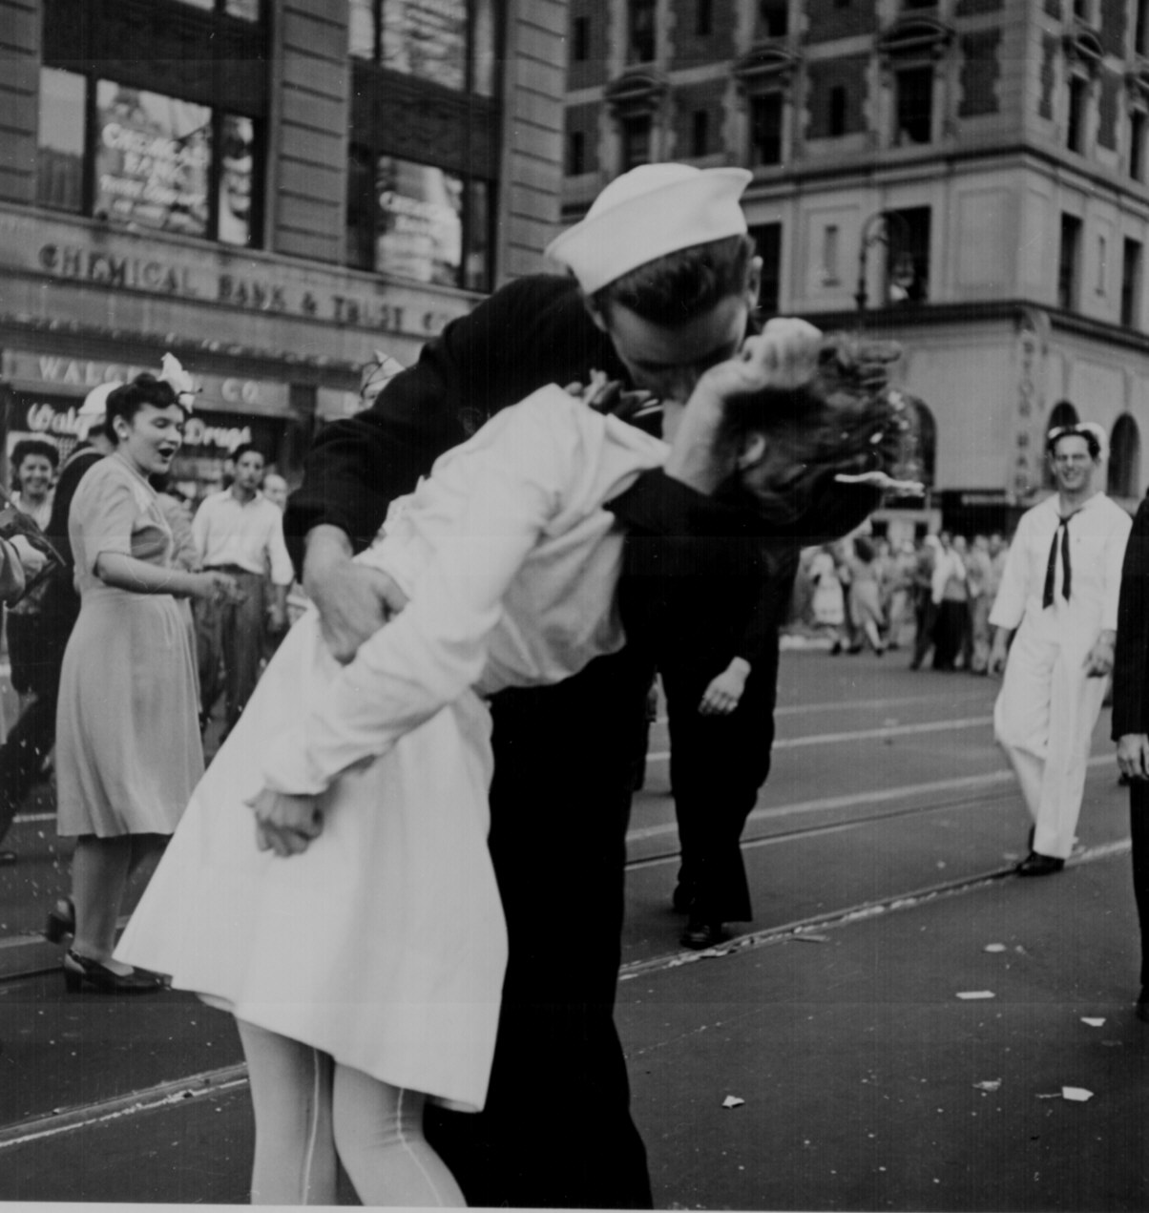
V-J Day in Times Square, NYC

Slide 29
Timeline of Events
December 7th Japan attacks Pearl Harbor
Philippines fall to the Japanese
April 1942 Bataan Death March
May 1942 Battle of Coral Sea
1944 Mac Arthur returns to the Philippines
February 1945, Marines capture Iwo Jima
August 6, 1945, First Atomic bomb dropped on Hiroshima
August 9, 1945, Atomic bomb dropped on Nagasaki
September 2, 1945, Japan surrenders V-E Day

Slide 30
War is Over!!! What Next?

