Slide 1
Labor Unrest Red Scare Booming Economy Prohibition Great Depression
After the War in the United States

Slide 2
Vocabulary
Prohibition
Communism
Buying on credit
Installment buying
Bull market
Overproduction
Stock
Bankruptcy

Slide 3
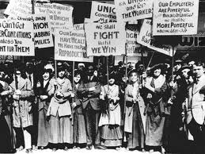
World War is Over, The Economy suffers
The end of WWI was followed by a severe recession in agriculture and industry
Production levels for the war no longer needed. Put many out of work. Few jobs for returning soldiers.
For industry, that downturn did not last long.
Industrial production climbed 70% between 1922 and 1928

Slide 4
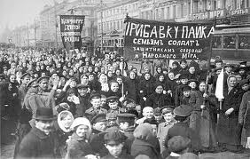
Communist Revolution
Russia’s Czar was over thrown before the end of WW1 in Nov. 1917.
Russia’s new Communist govern was the first gov of its kind.
Communism is an economic and political system in which the state owns the means of production and a single political party rules.

Slide 5
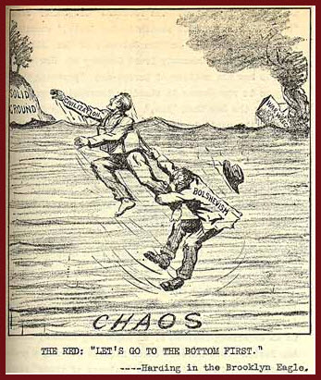
Communism is now seen as our new Enemy
Communism is not a democratic form of government.
US government didn’t want to recognized Russia diplomatically because Communism is opposed to democracy.

Slide 6
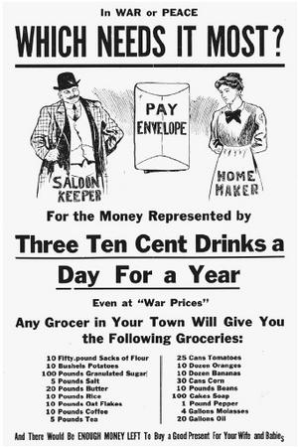
PROHIBITION
1800’s Progressives wanted to reduce alcohol use in US.
Supported during WW1 to conserve grains for the war effort.
18th Amendment ratified in 1919…prohibited making, selling, or transporting alcohol….known as Prohibition!

Slide 7
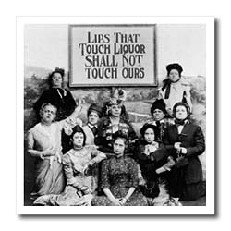
Prohibition
Law was hard to enforce!
Smuggling alcohol from Canada and the Caribbean brought huge profits.
Organized crime saw the profits, gang wars broke out in parts of the country.

Slide 8
Booming Economy Good Times will never End!!!!!
Roaring Twenties

Slide 9
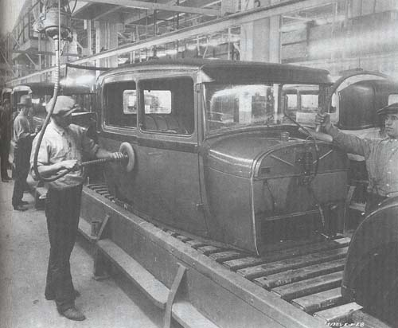
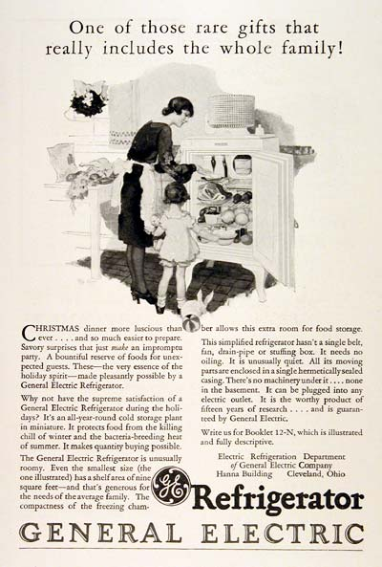
The Roaring Twenties
As more goods came to the market, prices dropped overproduction
Rising incomes gave consumers more to spend.

Slide 10
Great Economy “Let the Good Times Roll”
Cultural Changes

Slide 11
Vocabulary
Red Scare
Anarchists
Harlem Renaissance.
Charles Lindbergh
Prohibition
Scopes Trial

Slide 12
What was America like Culturally after WWI
Russia and the Communists government became the new enemy of America.
Great immigrant migration, produced fear in Americans that the new immigrants we communists and Anarchists passed laws to limit immigration
Prohibition promoted organized crime, “gangsters” because Americans wanted to drink

Slide 13
American Culture
Automobiles made Americans more mobile exposed to new things.
Entertainment: Radio, and Movies, and a new kind of music, JAZZ
The Scopes trial, about evolution being taught in schools.
African Americans returning from the War, demanded equality at home. Racial Riots
New frontiers: Charles Lindbergh flying solo across the Atlantic to Paris

Slide 14
American Culture
Writing abound, F. Scott Fitzgerald’s The Great
Gatsby, Langston Hughes, African American major part of the Harlem Renaissance.
All these changes that were happening in the American Culture and Society came
From the Booming Economy where people had more resources to spend on leisure
Activites and goods. People thought this booming economy would never end, so they
Began to take financial risks thinking the economy would always be this good……
Was that the reality?

Slide 15
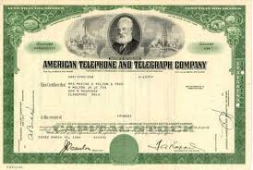
Stocks
With a strong economy, more people chose to invest in the stock market
A stock is a share of ownership in a corporation

Slide 16
Bull Market
Strong Economy
Strong economy-factories changed from making war goods to consumer goods.
Abundance of goods flood US market.
To encourage consumers to buy…offer people installment buying/or buying on credit.
People began to buy stocks on margin—borrowing money in order to buy stocks.

Slide 17
Signs of Trouble !!!!!!!
Farmers
Agricultural Depression
Grew more crops than Americans could use
Before WW1 could sell excess, after countries too poor to purchase excess
High Debt
Before war farmers had good years, took out loans to buy more land and equipment.
Unable to pay off debts

Slide 18
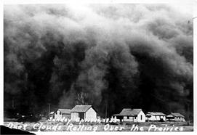
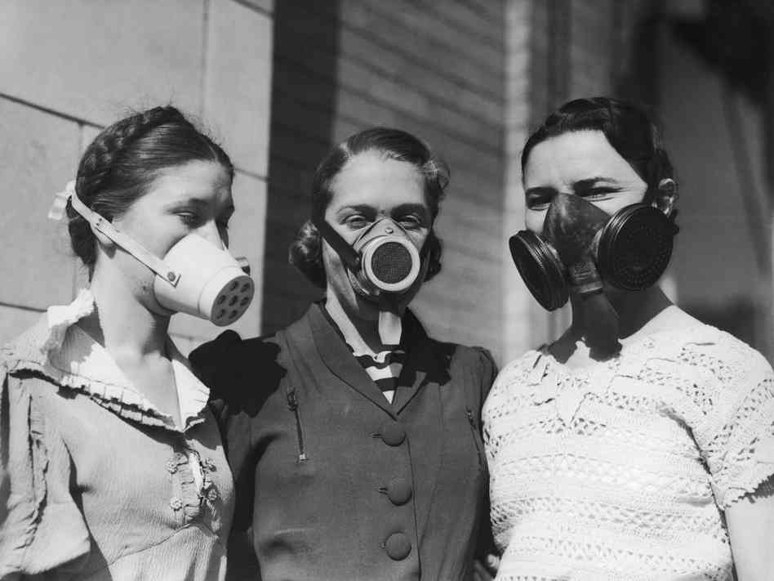
DUST BOWL
Storm advancing on a small town
Over farming the land and years of drought caused huge dust storms that picked up the dust and carried it1000’s of miles from the prairie lands of the mid west as far as to ships on the Atlantic Ocean and New York City.
Masks used to help them breath during a dust storm

Slide 19
Signs of Trouble !!!!!!
Workers--- due to assembly line system skilled workers weren’t as needed. Less expensive unskilled workers could handle the simpler tasks on the assembly line………Therefore lower pay!
Older industries--coal mining, railroads, clothing manufacturers were in decline.
Manufacturers overproduced goods, there are now more goods than people could buy.

Slide 20
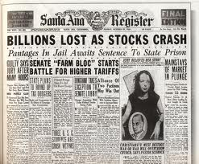
Great Depression Begins
The Crash!!
Industrial Stocks rise between May and September 1929. Soon after Stock prices begin a rapid slide Downward.
Wed, Oct 23rd, 6 million stocks change hands, creating a loss of 6 billion.
Tues. Oct 29th Traders try to sell
Stock..no buyers, prices of stock fall, people lost all their money.
Those that borrowed money to by Stocks couldn’t pay it back.

Slide 21
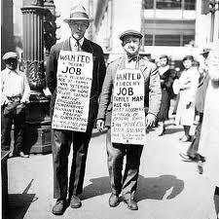
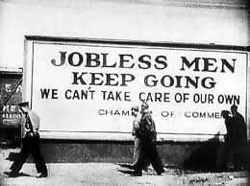
Great Depression Begins
The Crash!!
Banking: Farmers couldn’t pay back their loans. Many small banks failed because people couldn’t pay it back.
Many large banks speculated in the stock market and loaned huge amounts to speculators who purchased stocks that are now worthless and couldn’t pay loans back.

Slide 22
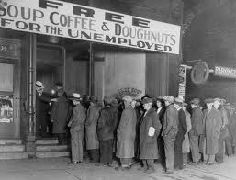
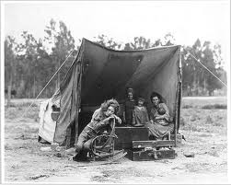
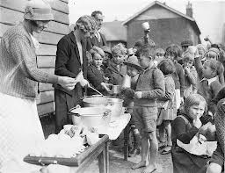
Results of Depression
No job, not able to Buy food. Soup kitchens Often provided the only meal thousands
would have every day!
People couldn’t pay for their homes so they lost them!

Slide 23
Who was to Blame for the Great Depression?
President Hoover thought businesses and local governments should voluntarily create public work projects to hire the jobless.
This didn’t work and he Lost the 1932 elections
Franklin Roosevelt was elected and he was aggressive in using the government to create jobs

Slide 24
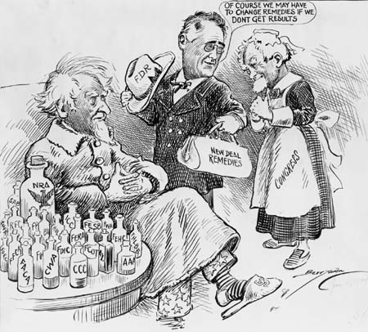
The New Deal instituted by President Roosevelt, to put people to work.
Between 1933 and 1935, the government began a programs designed to provide jobs, reform financial regulations, and stimulate the economy.
Several New Deal programs remain functional today;
FDIC---Federal Deposit Insurance
SEC---Security and Exchange
FHA---Federal Housing Admin
Agricultural Adjustment Admin (AAA)

Slide 25
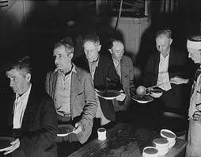
Reform Efforts of the New Deal
Social Security Act gave industrial workers their first retirement pension.
Streets and airports were built with federal money.
Rural electric co-ops meant more lights for farming communities.
The state’s tobacco industry enjoyed great profits due to more people smoking.
Notes:
25

Slide 26
Summary World War I Brought many Changes
Agriculture went through a recession. Overproduction of food.
New anti-democratic government, Communism is established. America feels they have an enemy.
19th amendment is passed and alcohol is now illegal in the United States. Organized crime exposes in the United States.
Overproduction, installment spending (credit) stocks being overvalued, banks over lending, banks investing in the stock market, all contributed to the crash of the stock market.
Dust bowl impacted the whole country.

Slide 27
Summary World War I Brought many Changes
From the crash millions out of work.
President Roosevelt spearheads federal programs to confront unemployment and the economic problems. Many programs are still intact today. Like Social Security.

