Slide 1
The Glided Age and the Reform movement
Everything is not what it appears to be!

Slide 2
Vocabulary
Glided Age
Progressive Movement
Corruption
Spoils system
Recall
Initiative
Referendum
16th Amendment
17th amendment
Muckraker

Slide 3
Introduction
By the late 1800s giant corporations controlled much of American business. You will learn why many Americans began to demand that the government control the power of these huge trusts and monopolies.
The period after the Civil War was known as the Gilded Age. Gilded means “coated with a thin layer of gold paint.” It meant that beneath a attractive exterior (the gild, gold paint) there were real problems in American society.
Two concerns:
The new rich from the industrial revolution were getting their wealth at the expense of the public.
The other worry was corruption, or dishonesty in government through the connection with the rich industrialists

Slide 4
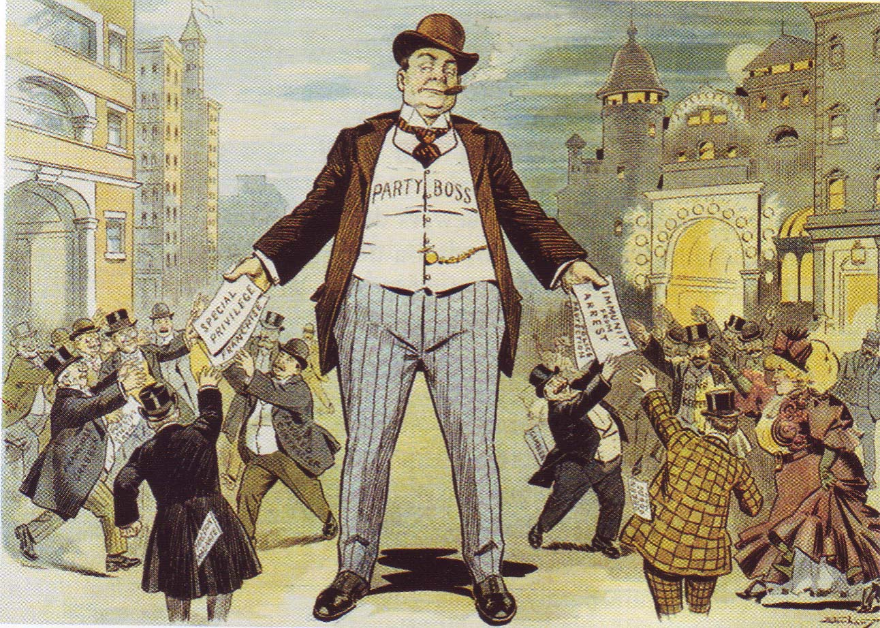
Corruption
Big business would bribe government officials so they would vote in a way that would benefit big business.
Politian's would grant government positions based on the spoils system. Government jobs were rewarded based of how much you supported the Politian

Slide 5
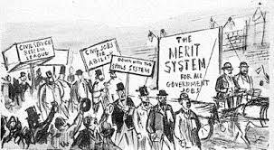
The Solution to the Corruption
The aim of the Civil Service Commission was to fill jobs on the basis of merit. To get a job jobs were awarded to those with the highest scores on civil service examinations

Slide 6
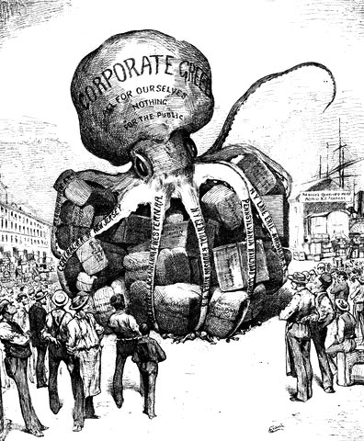
Big Business and Government
Big business had a strong influence over politics. Members of Congress bribed were bribed by Railroad owners and industrialists to buy their votes.
To combat this President Grover Cleveland signed the Interstate Commerce Act to enforce the power of Congress has to regulate interstate commerce..

Slide 7
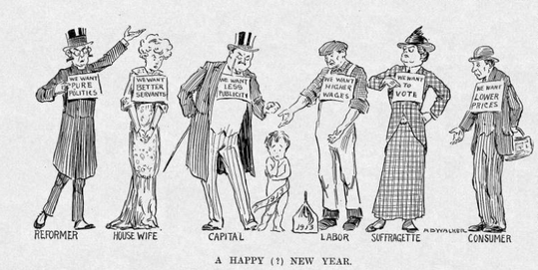
Progressives and Political Reform
Opposition to corruption led to the rise of the Progressive movement. The Progressives were a diverse group of reformers united by a belief in the public interest, or the good of all the people.

Slide 8
Progressive Movement started in Wisconsin
Since the Age of Jackson, political party leaders picked candidates for local and state offices.
In 1903, Wisconsin was the first state to adopt a primary run by state government officials. A primary is an election in which voters, rather than party leaders, choose their party’s candidate.

Slide 9
Other progressive reforms
Party leaders pick local candidates for state and local offices.
Only members of state legislatures can introduce bills
Only legislators can pass laws
Only courts or legislature can remove corrupt Politian
PRIMARY
Initiative
Referendum
recall
Voters select their party candidate
Voters can propose bills to the legislature s
Voters can vote on bills directly
Voters can remove elected officials from office

Slide 10
What we have today from the progressive movement
RECALL, a process by which people may vote to remove an elected official from office.
The INITIATIVE is a process that allows voters to put a bill before a state legislature. to propose an initiative, voters must collect a certain number of signatures on a petition.
The REFERENDUM is a way for people to vote directly on a proposed new law.

Slide 11
Progressive Constitutional Amendments
The Sixteenth Amendment (1913), which gave Congress the power to pass an income tax. The wealthy pay taxes at a higher rate than the poor or the middle class.
The Seventeenth Amendment ratified in 1913, required the direct election of senators not elected by state legislators

Slide 12
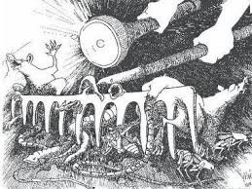
Muckrakers
The Muckrakers
The press played an important role in exposing corruption and other problems. President Theodore Roosevelt compared reporters who uncovered problems to men who raked up dirt, or muck, in stables. Muckraker became a term for a investigating journalist.

Slide 13
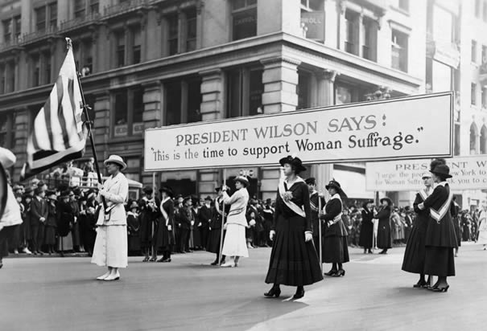
Women suffrage
Progressive movement leads the push for women getting the right to vote
Amendment 19th giving women the right to vote was passed by 2/3rds of the states by 1920.

Slide 14
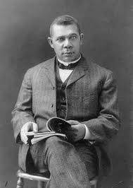
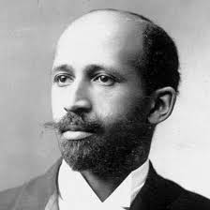
Progressive movements in the African American Community
Booker T. Washington
W.E.B.Debois

Slide 15
African American Rights
In 1881, Washington helped found the Tuskegee Institute in Alabama. The school offered training in industrial and agricultural skills
Washington advised African Americans to learn trades and seek to move up gradually in society. Eventually, they would have money and the power to demand equality.
Du Bois was the first African American to receive a Ph.D. from Harvard University. He agreed with Booker T. Washington on the need for “thrift, patience and industrial training.” However, Du Bois criticized Washington for being willing to accept segregation:
Du Bois urged blacks to fight discrimination rather than patiently submit to it. In 1909, he joined other reformers forming the National Association for the Advancement of Colored People, or NAACP.
Booker T. Washington
W.E.B.Debois

Slide 16
Gilded Age and Progressives Review
Industrial Revolution promoted big business.
Big Business used their money and power to influence and control the government and laws passed
Progressives fought the influence, by protesting and passing laws that limited the influence of Big Business
The Progressive movement influenced women to fight for suffrage and African Americans to equal treatment.

