Slide 1
US Constitution
Our Government

Slide 2
Vocabulary
Popular Sovereignty: People are the source of the government’s power
Republicanism: People elect their political representatives
Limited Government: The Constitution limits the actions of government by specifically listing powers it does and does not have
Federalism: In this government system, power is divided between national and state governments
Separation of Powers: Each of the three branches of government has its own responsibilities
Checks and Balances: Each branch of government holds some control over the other two branches
Individual Rights: Basic liberties and rights of all citizens are guaranteed in the Bill of Rights

Slide 3
Vocabulary continued
Enumerated Powers: Powers that are specifically spelled out in the Constitution for each branch of government.
Concurrent Powers: Powers that are held by both the federal government and the state
governments.
Reserved Powers: a political power that a constitution reserves exclusively to the jurisdiction of a particular political authority.

Slide 4
Constitution: Ideas it is based on.
Based on:
Magna Carta (1215)
English Bill of Rights (1689)
Enlightenment (1700s)
John Locke (1690)
Two Treatises of Civil Government
Baron de Montesquieu
The Spirit of Laws (1748)

Slide 5
Constitution: Principles the parts of the Constitution apply to the branches of government.
Parts
Preamble: Introduction
Articles
I: Legislative Branch
II: Executive Branch
III: Judicial Branch
IV: Relations among States
V: Amendment Process
VI: National Supremacy
VII: Ratification
Sections
Amendments
Principles
Popular Sovereignty
Republicanism
Limited Government
Federalism
Separation of Powers
Checks and Balances
Individual Rights

Slide 6
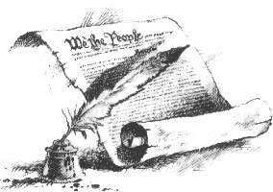
Preamble: introduction to the Constitution
We the People of the United States, in Order to form a more perfect Union, establish Justice, insure domestic Tranquility, provide for the common defense, promote the general Welfare, and secure the Blessings of Liberty to ourselves and our Posterity, do ordain and establish this Constitution for the United States of America.

Slide 7
Legislative Branch
Senate
100 Senators
Represent state
30 yrs. Old
6 yr. term
Approves treaties
Confirms nominations
Passes legislation
House
435 Representatives
Represent district
25 yrs. Old
2 yr. term
Originates revenue bills
Impeach federal officials
Passes legislation
House of Representatives plus Senate
= US CONGRESS

Slide 8
Executive Branch (President and the Cabinate)
Nominate members to the federal judiciary
Veto laws passed by Congress
Commander in Chief of military
Pardons and Reprieves
State of the Union (Speech to Congress,
Presidential Cabinet, US Supreme Court
Recommends Legislation
Execute Laws (Dept. of Justice)

Slide 9
Judicial Branch
US District courts
US Appeals courts
US Supreme Court
Judicial Review

Slide 10
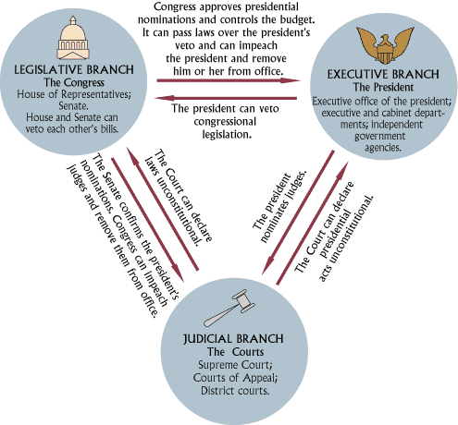
CHECKS AND BALANCES BETWEEN THE BRANCHES OF GOVERNMENT

Slide 11
Regulate Trade
Coin Money
Provide an Army & Navy
Conduct Foreign Affairs
Set Up Federal Courts
Enforce Laws
Establish Courts
Collect Taxes
Borrow Money
Provide for General Welfare
Regulate Trade w/in the State
Establish Local Government
Conduct Elections
Establish Public School Systems
Concurrent
Powers

Slide 12
Amending the Constitution
Nationally Driven
Congress
2/3 vote of both houses
¾ of states
State Driven
Constitutional Convention called by 2/3 of states
¾ of states

Slide 13
Elastic Clause
Article 1, Section 8
Congress shall “make all Laws which shall be necessary and proper”
Implied powers of the Congress

Slide 14
Amendments
Personal Rights & Freedoms
Right to Bear Arms
Quartering of Troops
Search & Seizure
Rights of Accused
Right to Speedy Trial
Right to Trial by Jury
No Cruel & Unusual Punishment
Powers Reserved to People
Powers Reserved to States
Limits Suits Between States
Election of President & Vice-President
Abolition of Slavery
Former Slaves’ Rights
Right to Vote
Allows Income Tax
Election of Senators
Prohibition
Suffrage
Lame Duck
Repeal of Prohibition
Term Limits
District of Columbia
Abolition of Poll Tax
Outlines Presidential Succession
Lowers Voting Age
Limits Congressional Salaries

